Slide 1
MLOps with Vertex AI
Productionizing ML with Google's best practices and tools
Kaz Sato, Developer Advocate, Google Cloud

Slide 2
Agenda
1
MLOps at Google
2
Vertex AI
3
MLOps with Vertex Pipelines
4
Vertex Model Monitoring
5
Vertex Feature Store

Slide 3
MLOps at Google
01

Slide 4


Launching is easy,
Operating is hard.
"The real problems with a
ML system will be found
while you are continuously operating it for the long term"
CC0 images from pixabay.com

Slide 5
Data Verification
Monitoring
Configuration
Data Collection
ML Code
Analysis Tools
Serving Infrastructure
Process
Management Tools
Machine Resource Management
Feature Extraction
Hidden Technical Debt in Machine Learning Systems, NeurIPS 2015
Notes:
Putting together a system of technologies and processes for managing Data, Models, and Code opens up a pandora’s box of challenges that ML teams face hidden beneath the surface.
As shown in this diagram from the canonical Google paper “Hidden Technical Debt in Machine Learning Systems”, the bulk of activities, time and expense in building and managing ML systems is not in Model training, but in the myriad ancillary tasks that make an ML system ‘work’.

Slide 6
What's happening today: Data Science and IT (Ops) are isolated
Training
Data Science
Serving
IT
Local Data
Manually sample
Training Data
Ad hoc Exploratory Data Analysis
Manual Data
Preparation
Model Training
Production Model Training
Trained Model
Prepare serving environment
Model
Deployment
Manual Model
Analysis
Rewrite Productionized Code
Rewrite & retrain
Unsupported dependencies / unavailable data
Notes:
And so, teams across all industries and domains find themselves swimming upstream today – without the necessary people, processes, or technology to address these challenges.
As shown in this illustrative workflow, there are a number of patterns we see, including:
[Manual] High degree of manual, one-off work – even in steps in the ML workflow that are known to be iterative
[Inflexible] No reusable or reproducible components
[Error prone] Poorly documented handoffs between Data Science and IT as models are chucked over the wall to be productionized
And so, what we have is a mess: teams find themselves stuck with manual, time-consuming, inflexible, and error prone workflows, falling short of their goals while costing their organizations precious time and money.

Slide 7
The Challenges on Productionizing ML
ML challenges
Governance of data, features, models, pipelines and experiments
Continuous training and deployment
Training-serving skew
Data validation
Model analysis
Fairness and Explainability
Production system challenges
Scalability
Availability
Portability
Reproducibility
Modularity
Monitoring and Alerting
Security
Hosted or Serverless

Slide 8
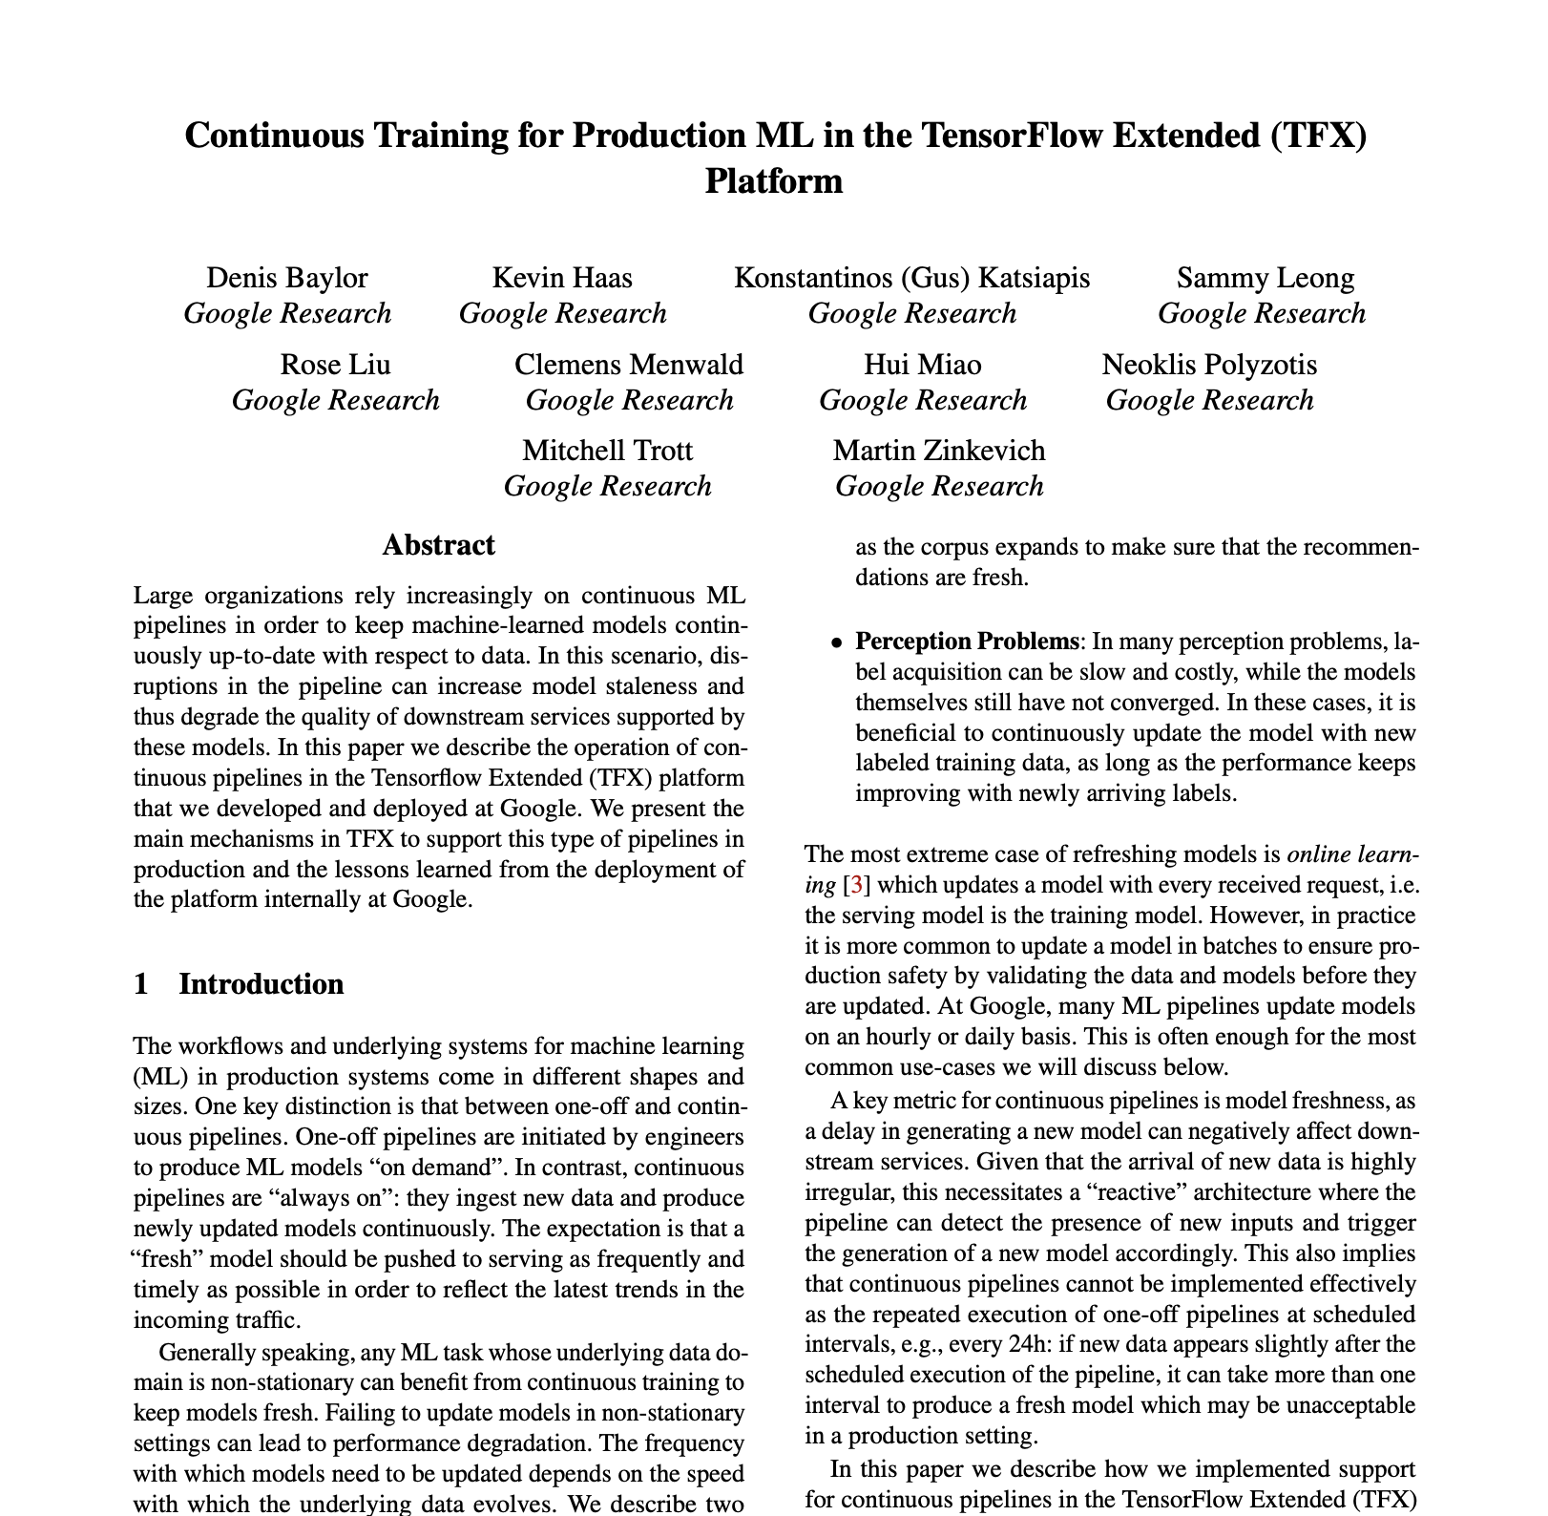
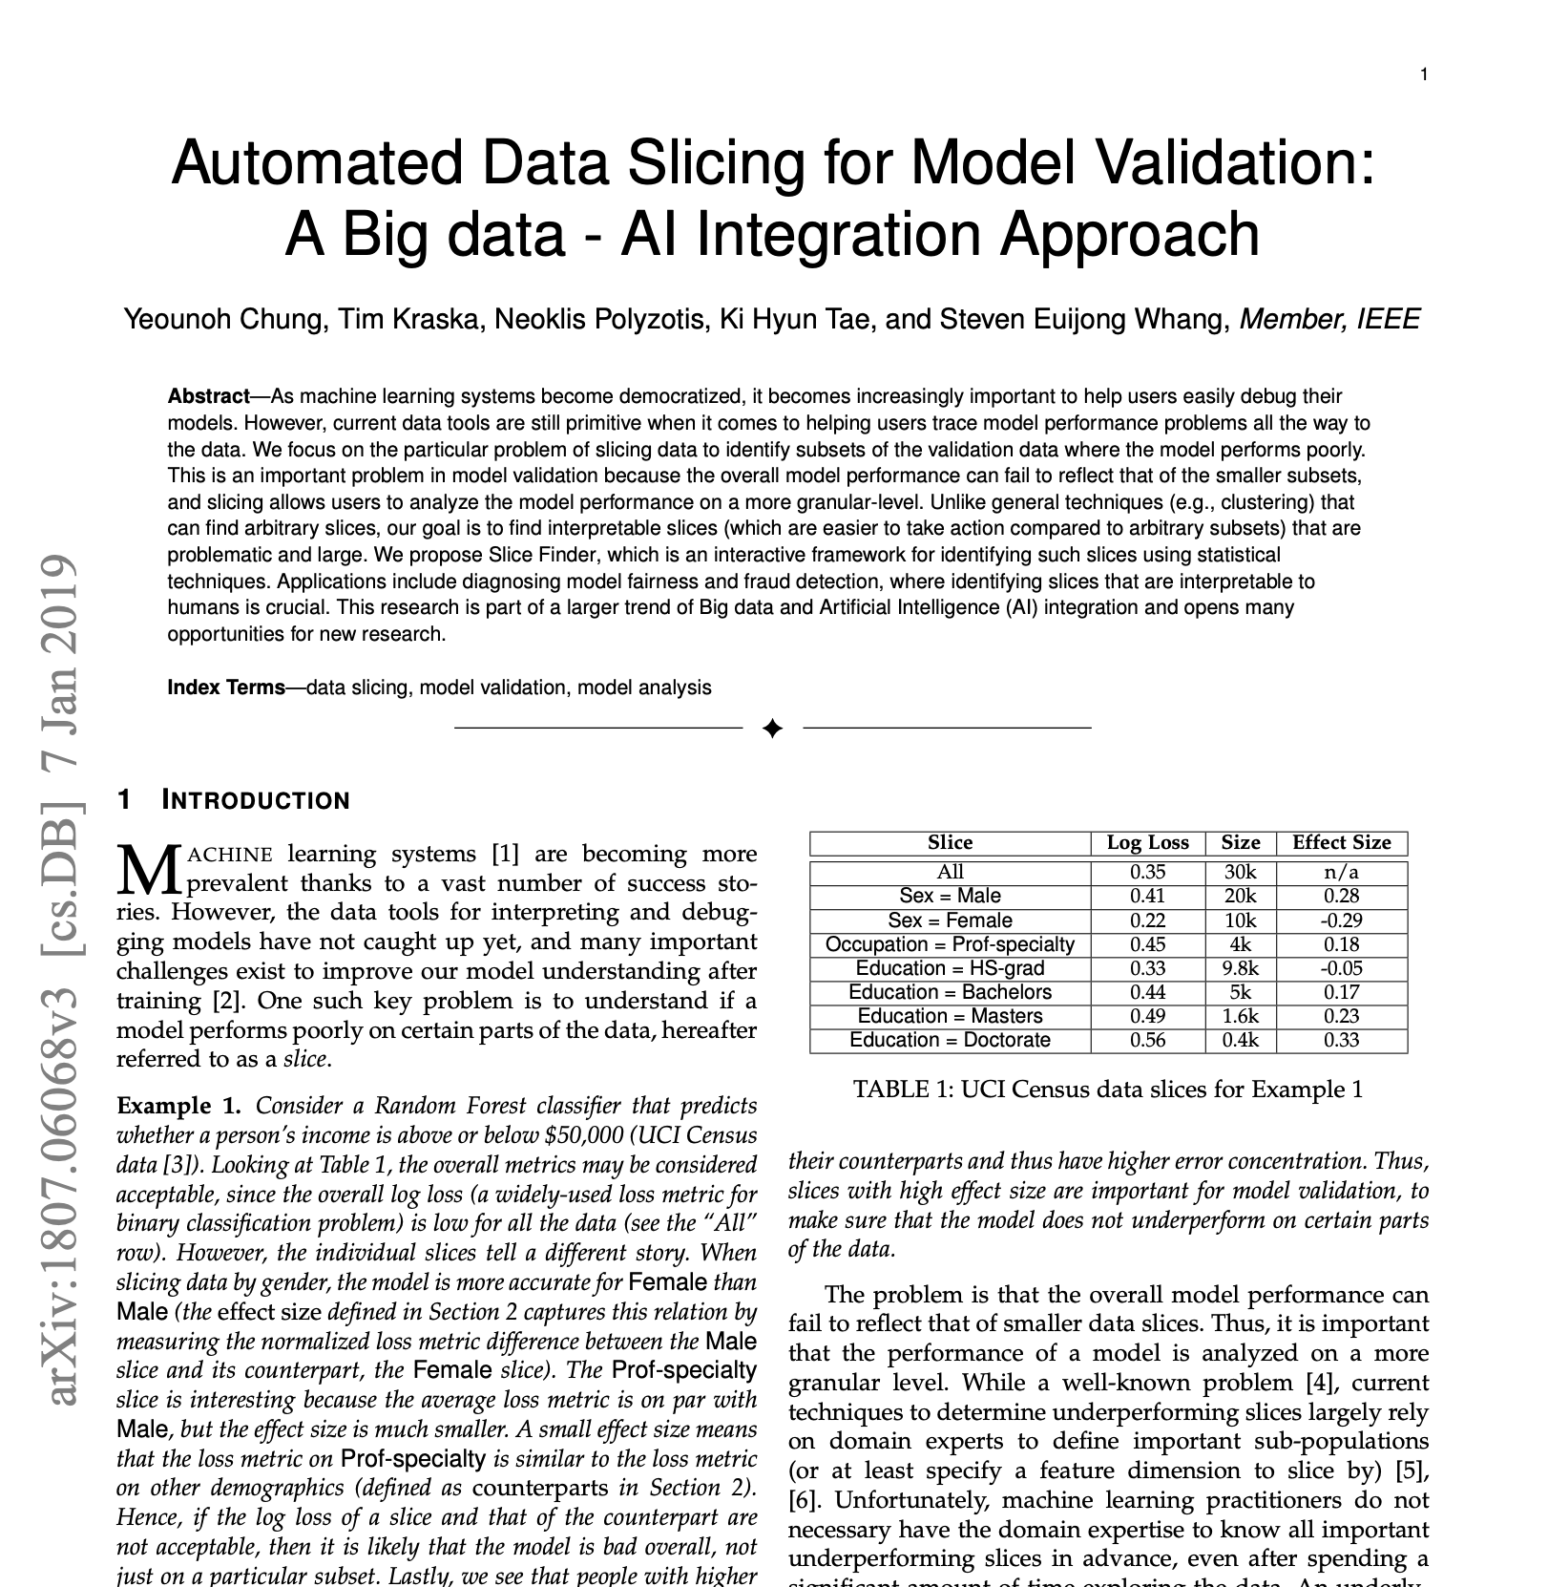

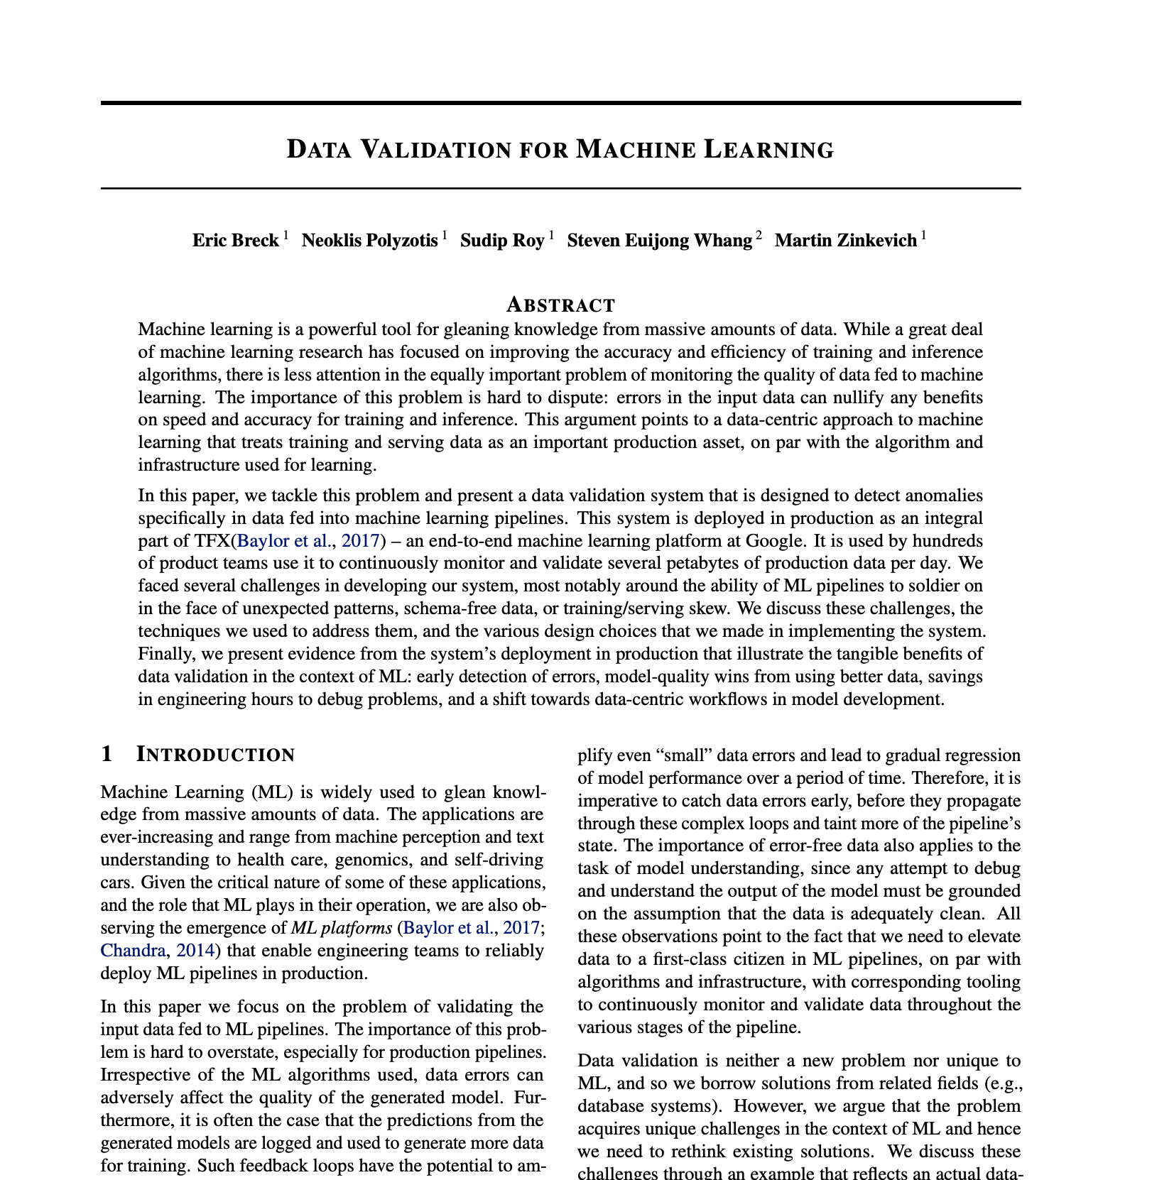
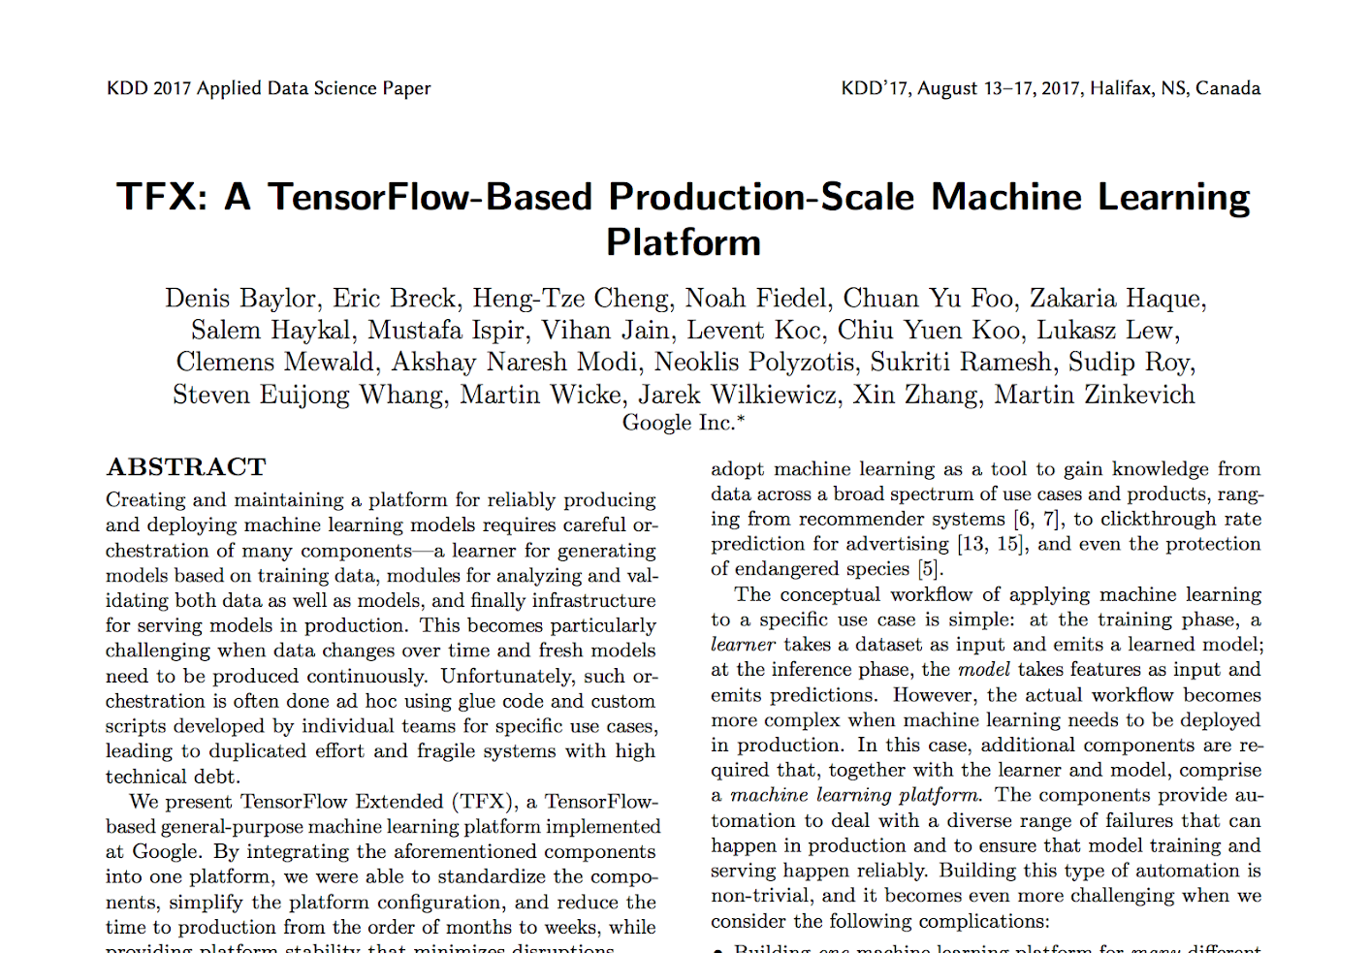
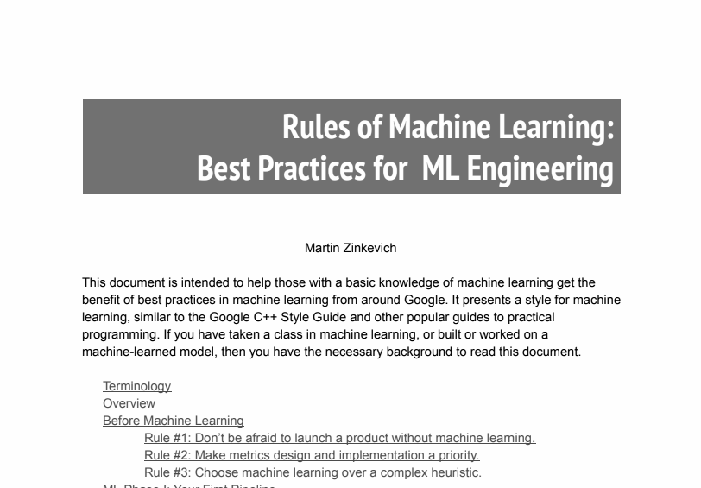
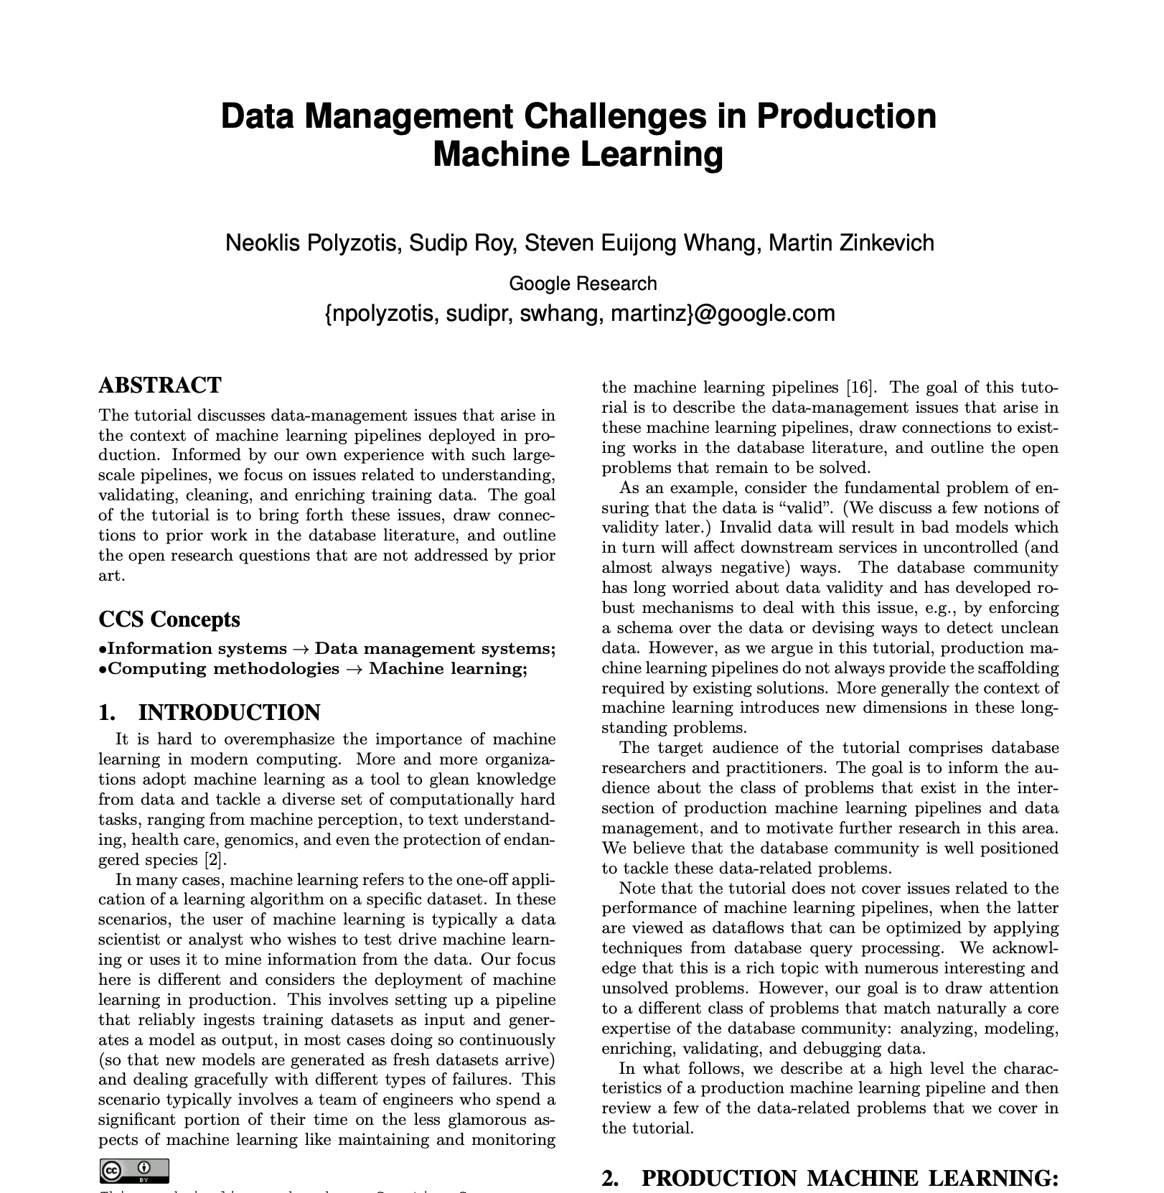
The History of Productionizing ML at Google
Continuous Training for Production ML in the TFX Platform. OpML (2019).
Slice Finder: Automated Data Slicing for Model Validation. ICDE (2019).
Data Validation for Machine Learning. SysML (2019).
TFX: A TensorFlow-Based Production-Scale Machine Learning Platform. KDD (2017).
Data Management Challenges in Production Machine Learning. SIGMOD (2017).
Rules of Machine Learning: Best Practices for ML Engineering. Google AI Web (2017).
Machine Learning: The High Interest Credit Card of Technical Debt. NeurIPS (2015).
Hidden Technical Debt in Machine Learning Systems. NIPS (2015).

Slide 9
MLOps
An ML engineering culture and practice that aims at unifying ML system development (Dev) and ML system operation (Ops)
Notes:
And so, enter the burgeoning discipline of MLOps – a culture and practice that aims to unify ML system development and operations and guide teams through the challenges of doing production machine learning.
It takes both its name as well as some of the core principles and tooling from DevOps. This makes sense as the goals of MLOps and DevOps are practically the same: to shorten the systems development life cycle and ensure high quality software is continuously developed, delivered, and maintained in production.
Its Machine Learning’s unique challenges and needs – managing the lifecycle of Data, Models, and Code – that has led MLOps to quickly evolve as a domain of its own.

Slide 10
Vertex AI
02

Slide 11

Vertex AI is a managed ML platform for every practitioner to speed the rate of experimentation and accelerate deployment of AI models.
Notes:
That’s why we created Vertex AI, a new managed machine learning platform to help you accelerate experimentation and deployment of AI models.
You heard about this a bit in the Developer Keynote, I wanted to take this opportunity to get into more product details.

Slide 12















A platform for all users and intents throughout the ML lifecycle
Product Manager
Insights and objectives
Data analyst
Query and analyze
Data engineer
Get clean, useful data
Data scientist
Models that work
ML developer
Intelligent apps
ML engineer
Models in production
Interactive BI
Looker
Endless EDW
BigQuery
Self-driving infra
BigQuery, Dataflow, Composer
Portable notebooks
AI Platform Notebooks
Images, videos
Vision, Video Intelligence
Scalable model hosting
AI Platform Prediction
EDW in a Spreadsheet
Connected Sheets
Self-managed data pipelines
Data Fusion, Dataflow
Broad choice of tools/language
Dataproc, Dataflow
Model eval and selection
Explainable AI, Experiments
Sentiment analysis, entity extraction
NL, Translation
ML CI/CD and orchestration
AI Platform Pipelines
Natural Language Query
Data QnA
Data models, catalog
Looker, Data Catalog
Data quality /lineage
AI Platform, BigQuery, Dataflow
Point-and-click dev
AutoML
Chatbots, voice commands
Conversation
Provenance and lineage
ML Metadata Management
Machine learning in SQL
BigQuery ML
Real-time capabilities
BigQuery, Dataflow
Collaboration
Feature Store, AI Platform Pipelines
Fleet routing, forecasting
Optimization
Improvements and retraining
Continuous Monitoring
Notes:
There are many users within an organization who have a part to play in the ML lifecycle. Consider a product manager, who can simply type a natural language query using our Data QnA to pull necessary insights from BigQuery. To a data scientist who dabbles with different aspects of building and validating models. To an ML engineer who is responsible for the model to work without issues to end users in production systems. There are several users with different needs, and we have thoughtfully built a comprehensive platform to serve them all.

Slide 13
Vertex AI Overview
Data Readiness
Feature Engineering
Training/ HP-Tuning
Model serving
Understanding/ Tuning
Edge
Model Monitoring
Model Management
AutoML
Vision
Video
Language
Translation
Tables
Data Labeling
Feature Store
Training
Prediction
Hybrid AI
Continuous Monitoring
Metadata
Datasets
Vizier Optimization
Explainable AI
Experiments
AI Accelerators
Pipelines (Orchestration)
DL Environment (DL VM + DL Container)
Notebooks
Notes:
We’re making ML easier at every stage of the Developer workflow
Vertex AI has tools that span this entire workflow
From Data labeling, notebooks and models within a single console experience, to prediction tools and continuous monitoring.
All of these offerings may be familiar to you, but what really distinguishes Vertex AI is the introduction of new MLOPs features.

Slide 14

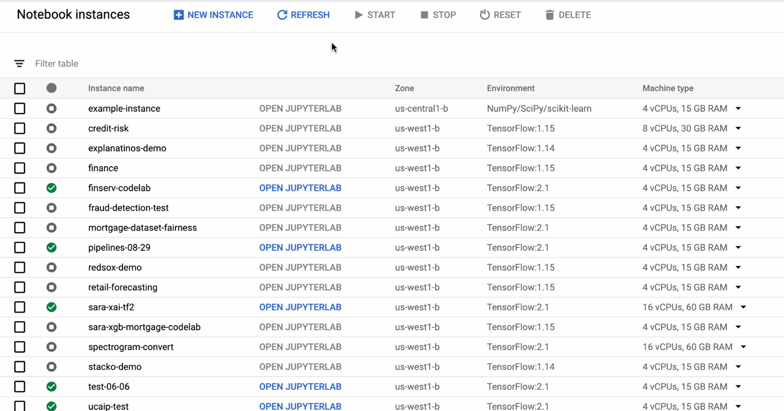
Notebooks
Jupyter Notebook on the Cloud
Data Science tools pre-installed
Integration with Google Cloud services: BigQuery, Dataflow etc
From 1 CPU to 16 A100s
Direct git integration

Slide 15
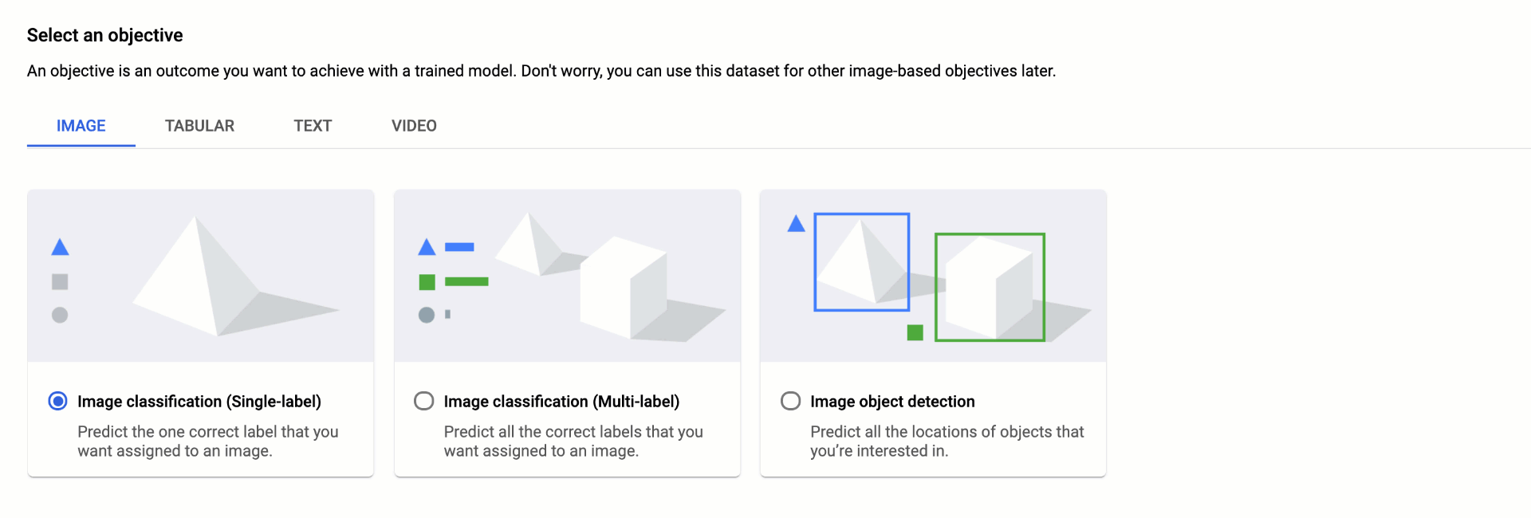
Animation flagged for post-production
Datasets
‹#›
Notes:
Why use managed datasets?
Discoverable from a central place
Lineage tracking
Annotation UI
Integrated data labeling
AutoML:
Point to your managed dataset
Kick off training job in the UI or programmatically via SDK
Custom model code:
Vertex AI passes training metadata to your custom training code
Choose from pre-built containers for training, or provide your own custom Docker container with training code

Slide 16
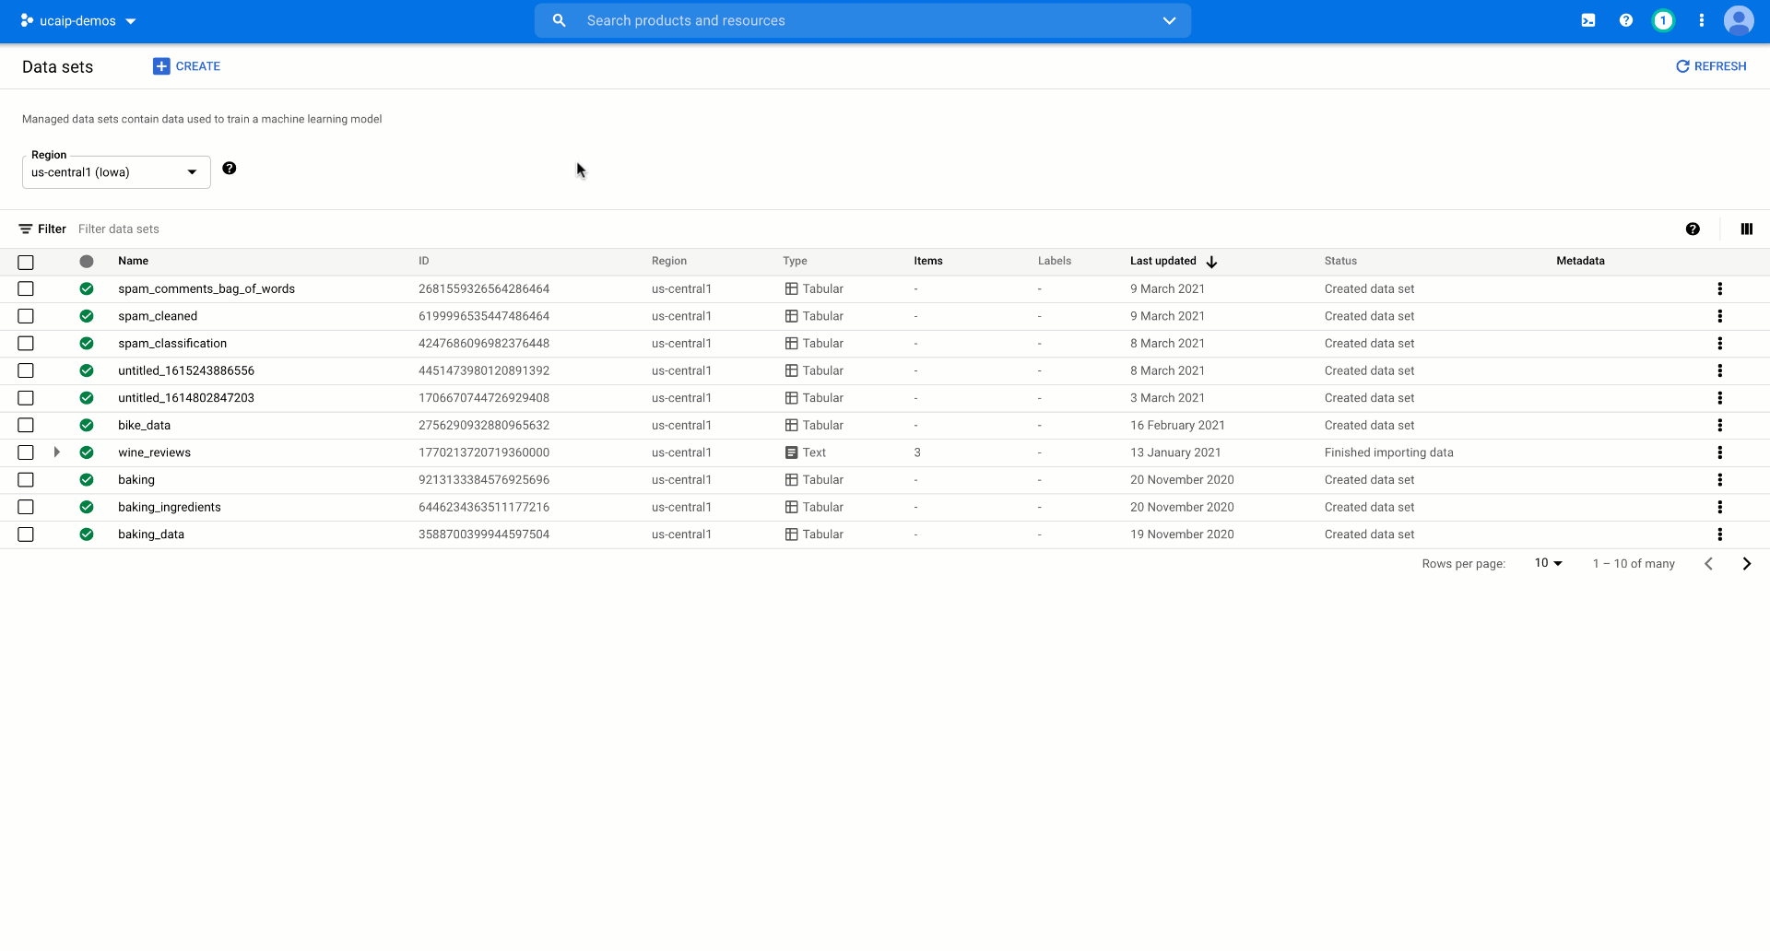
Animation flagged for post-production
AutoML Training
Train state-of-the art models in less time without writing model code
Get detailed model evaluation metrics and feature attributions, powered by Explainable AI
‹#›

Slide 17
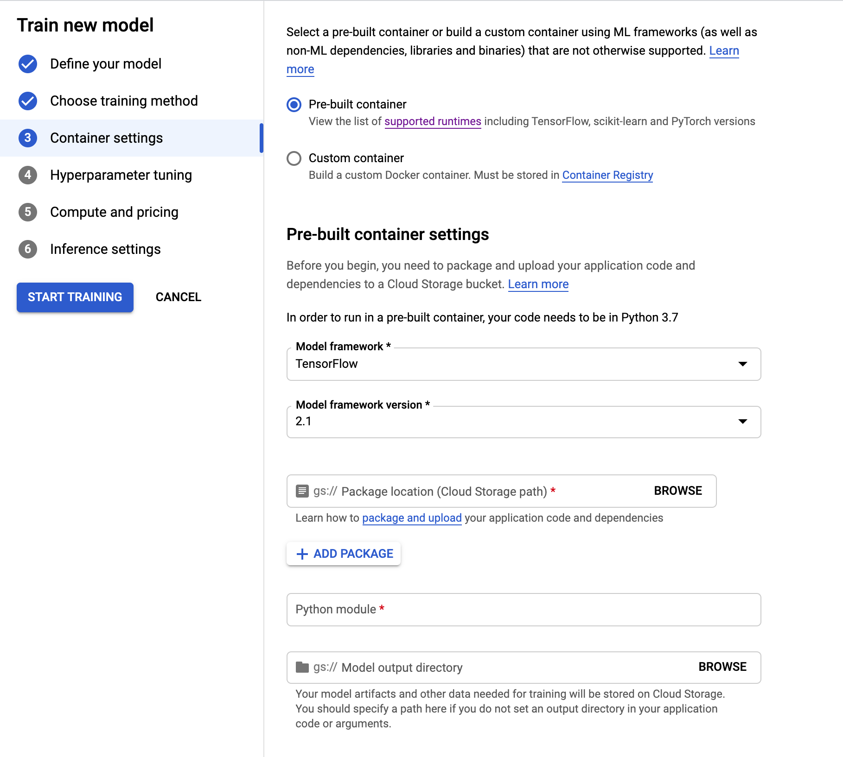
Vertex Training
Train models build with a framework of your choice via custom containers
Run distributed training jobs and accelerate training with GPUs
Hyperparameter tuning with Google’s advanced Vizier optimization algorithm
‹#›
Notes:
More talking points from Winston: serverless, enterprise security, scalable distributed training, job queuing, built-in logging and monitoring

Slide 18
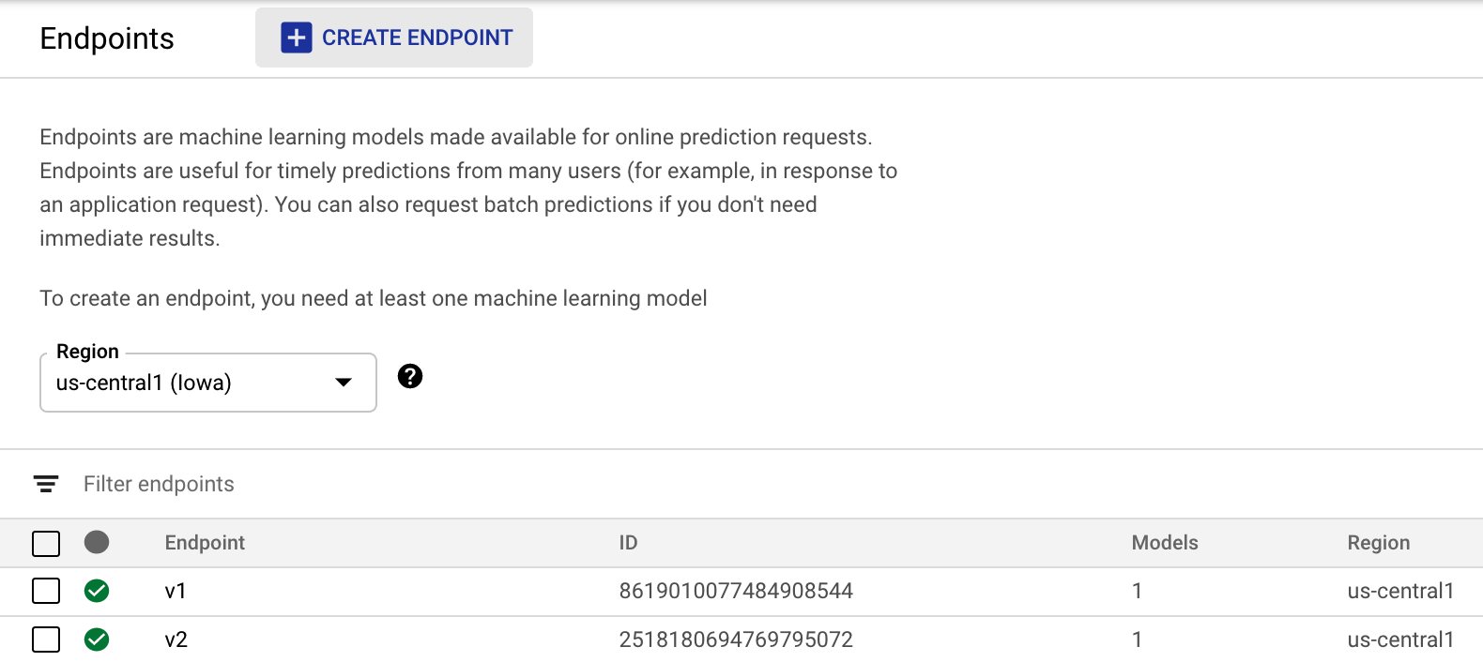
Scalable Endpoints with Vertex Prediction
Unified Endpoints experience
Models trained with AutoML
Models trained with custom code
Serve models built with most commonly used ML frameworks
Split traffic between models
Customize endpoint machine types
‹#›
Notes:
Regardless of whether you train with AutoML or your own custom model code, deployed models show up in the same place in the Vertex console and are accessible via the same API

Slide 19
Scalable training and serving on Vertex AI
Train with | Data Analyst | ML Developer | Data Scientist | Use when | Serve with
Vertex Training |  |  |  | Your problem doesn’t match the criteria listed below for BigQuery ML or AutoML. You’re already running training on-premises or another cloud, and you need consistency across the platforms. | Vertex Prediction
AutoML |  |  |  | Your problem fits into one of the types AutoML supports. Offers a point-and-click workflow. Natural Language or Video models are served from Google Cloud. While Vision and Tables support edge / downloadable models.
BigQuery ML |  |  |  | All your data is contained in BigQuery. Users are most comfortable with SQL. The set of models available in BigQuery ML matches the problem you’re trying to solve.
Train with
Data Analyst
ML Developer
Data Scientist
Use when
Serve with
Notes:
When it comes to building a model, there are three ways to do it.
BigQuery ML: if your data is in BQ, and the user is comfortable with SQL, then they can train a pre-canned model on their dataset using a simple SQL query.
Next up, AutoML: If the user wants to apply deep learning techniques to build custom models - for a wide variety of structured and unstructured data types, AutoML is a handy tool. It uses a simple neural architecture search technique to build models in a simple point-and-click workflow. No coding required. Some of the models can also be exported to be deployed at the edge.
Lastly, AI Platform Training: AI Platform provides a set of pre-built algorithms, and allows users to bring their custom code to train models.
Regardless of the training method, users can deploy the trained models with ease using AI Platform Prediction service.

Slide 20
MLOps with
Vertex Pipelines
03

Slide 21
MLOps challenges in ML lifecycle
ML Development
Feature Management
Code & Config
Training Operationalization
Training pipeline
Continuous Training
Registered model
Model Deployment
Deployed model
Prediction Serving
Serving logs
Continuous Monitoring
Notes:
You can now manage your models with confidence using our MLOps suite, to remove the complexity of robust self-service model maintenance and repeatability.
First, experimentation is a crucial component of ML to build the most optimal models.
You need tools that embrace the trial and error nature of ML and help you and your team track and manage your experiment.
With this in mind, we created the Vertex Feature Store.
It serves as the data source for experimentation, continuous training and online serving
This way you avoid training-serving skew, help prevent bias and ensure that up-to date feature values are served.

Slide 22

MLOps with Vertex AI: Pipelines
ML Development
Vertex
Feature Store
Code & Config
Training Operationalization
Training pipeline
Vertex Pipelines
Registered model
Model Deployment
Deployed model
Prediction Serving
Serving logs
Vertex Model Monitoring
Notes:
You can now manage your models with confidence using our MLOps suite, to remove the complexity of robust self-service model maintenance and repeatability.
First, experimentation is a crucial component of ML to build the most optimal models.
You need tools that embrace the trial and error nature of ML and help you and your team track and manage your experiment.
With this in mind, we created the Vertex Feature Store.
It serves as the data source for experimentation, continuous training and online serving
This way you avoid training-serving skew, help prevent bias and ensure that up-to date feature values are served.

Slide 23
“At Google, a hybrid research approach where engineers and researchers are embedded together on the same teams has helped reduce this source of friction significantly”
From ML Tech Debt paper

Slide 24
“Rule #8: Know the freshness requirements”
“Rule #16: Plan to launch and iterate”
From Rules of ML paper

Slide 25
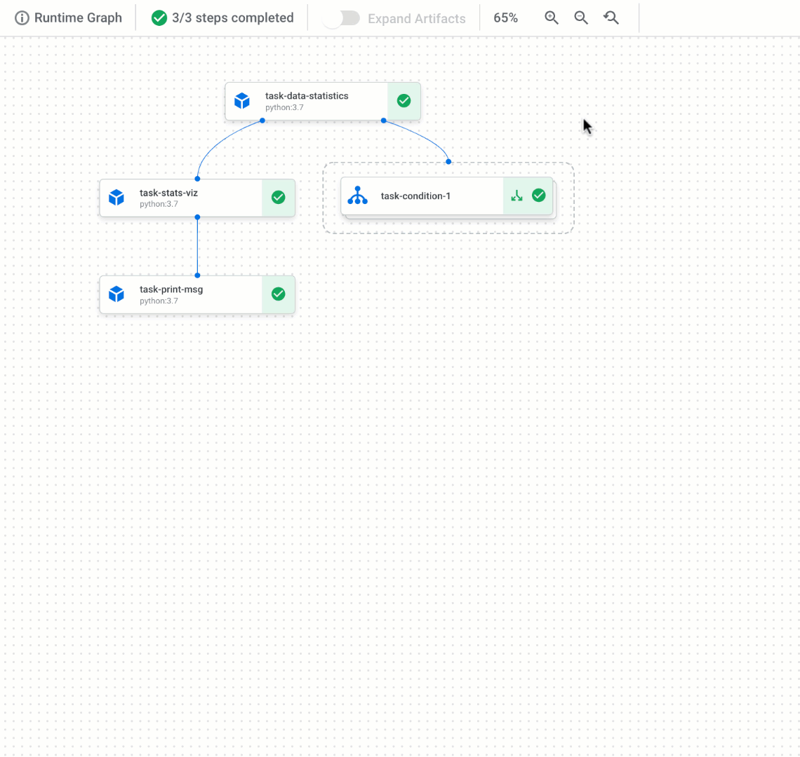
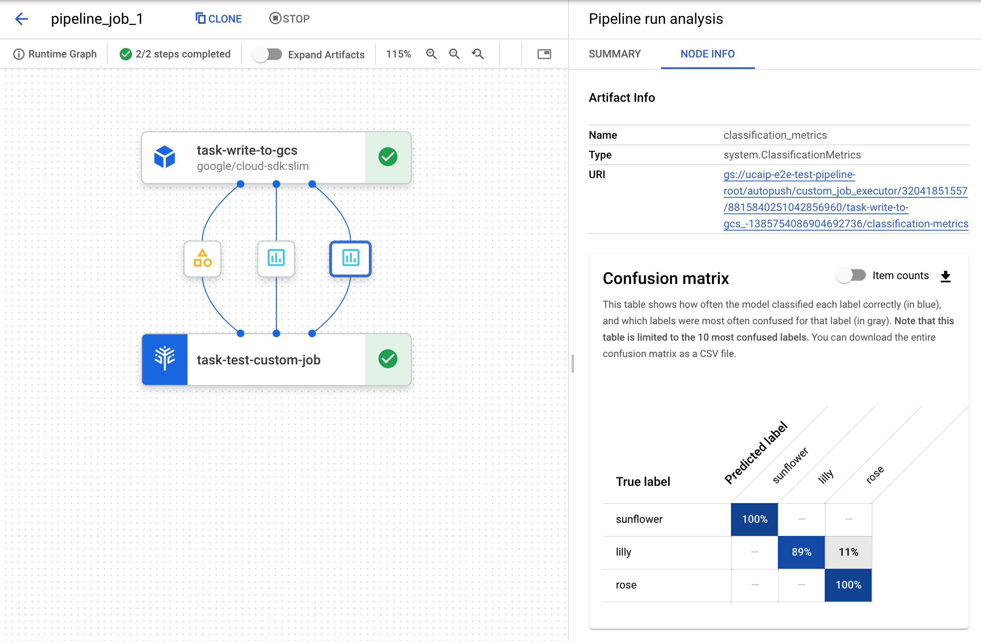
Vertex Pipelines
Define pipelines with your components for data ingestion, preprocessing, training, validation and deployment with Kubeflow Pipelines
Serverless, automated, scalable: pay only for what you use
Track artifacts and lineage of data, feature, model and experiment metrics across your ML workflow with metadata store for higher governance and auditing
‹#›
Notes:
Vertex Pipelines also have a metadata layer, to simplify the process of tracking artifacts generated throughout your pipeline.

Slide 26
Experimentation management with Vertex Pipelines
Iterative Experimentation
Development datasets / Features
Data
Prep
Feature
Eng
Model Training
Model
Eval
Training Pipeline Automation
Source
Repository
Training Pipeline Source Code
Parameters, metrics, artifacts
Experiment Tracking
Notes:
First things first, ML is experimental in nature. You should try different features, algorithms, modeling techniques and parameter configurations in this phase to find what works best for the problem. The challenge here is to track what worked, and what didn’t, and maintain reproducibility of the model in training and production systems while maximising code reusability. To achieve this efficiently, the steps of the ML experiment can be orchestrated using ML pipelines. This leads to rapid iteration, and better readiness to move to production. Our AI Platform has necessary tools and services like Notebooks, What-If Tool and Training that help with data exploration, model training, and model evaluation. We also offer AI Platform Pipelines to orchestrate these steps, and store it in the source code repository for future retraining of the models.
The output of the experimentation phase is a reliable, automated training pipeline.

Slide 27
Continuous Training with Vertex Pipelines
Training Pipeline CI/CD
Training Pipeline Source Code
Orchestrated Training Pipeline
Development datasets / Features
Data Extraction
Data
Valid.
Data
Prep.
Model
Training
Model
Eval.
Model
Valid.
Model Registry & Artifact Store
Trained Model
Training Pipeline Metadata
Notes:
Once you are done with experimentation, you build source code and run various tests. The outputs of this step are pipeline components (packages, executables, and artifacts) to be deployed in a later stage. GCP services like Cloud Build and Container Registry can be used in conjunction with AI Platform Pipelines to realize this Pipeline CI/CD.
The ML pipeline components should be reusable, composable, and potentially shareable. The source code for components must be modularized and ideally containerized. This will help you decouple the execution environment from the custom code runtime, make the code reproducible between different environments, and isolate each component.
The output of this phase is the validated trained model. Throughout the entire run, we’ve tracked the metrics and metadata for the pipeline alongside the model, retaining Model Provenance and ensuring we have traceability and auditability.

Slide 28
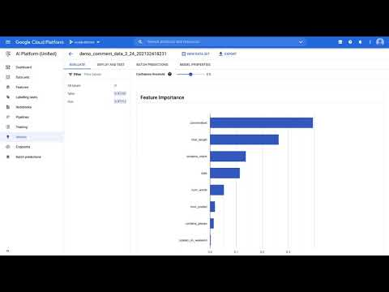

Slide 29
Vertex Model Monitoring
04

Slide 30
MLOps with Vertex AI: Model Monitoring
ML Development
Vertex
Feature Store
Code & Config
Training Operationalization
Training pipeline
Vertex Pipelines
Registered model
Model Deployment
Deployed model
Prediction Serving
Serving logs
Vertex Model Monitoring
Notes:
You can now manage your models with confidence using our MLOps suite, to remove the complexity of robust self-service model maintenance and repeatability.
First, experimentation is a crucial component of ML to build the most optimal models.
You need tools that embrace the trial and error nature of ML and help you and your team track and manage your experiment.
With this in mind, we created the Vertex Feature Store.
It serves as the data source for experimentation, continuous training and online serving
This way you avoid training-serving skew, help prevent bias and ensure that up-to date feature values are served.

Slide 31
“Rule #29: Make sure you train like you serve”
"Rule #37: Measure training-serving skew”
From Rules of ML paper

Slide 32
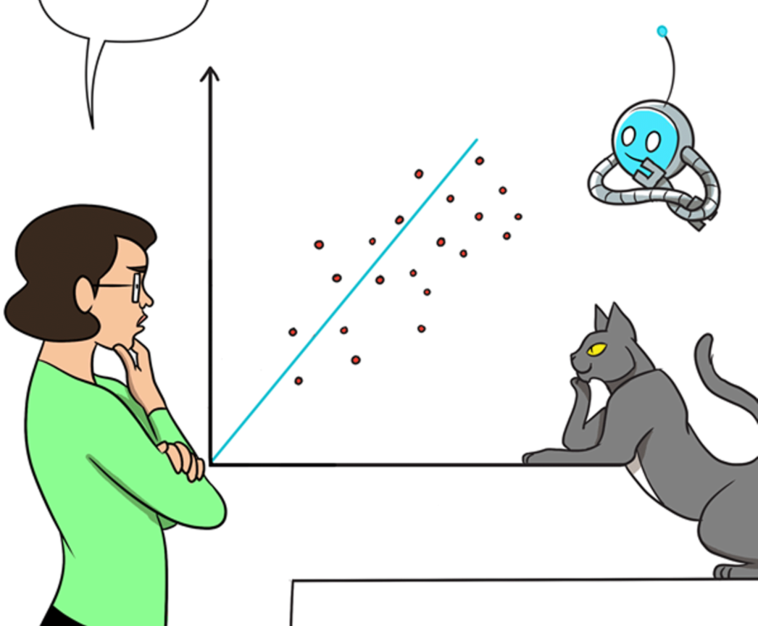
Why my model doesn't work well?
Any models get stale, as they are trained with data in the past
After the deployment, you would see degradation of performance and UX
Google
Notes:
The following slides are based on: https://docs.google.com/document/d/1wWIx1XvRDeEGMXMt4GMqdYP2_jsPwdZG5UucUKoj2PY/edit?ts=6082227b#heading=h.pi9tkoafs0yl

Slide 33



The Silent Killer: Skew and Drift
The important lesson learned at Google: Skew and Drift are the silent killers of your ML models
Training-Serving Skew:
Feature at training: green banana
Feature at serving: yellow banana
Prediction Drift:
Feature at serving: changing from green to yellow
Grandbrothers

Slide 34
We want the user to treat data errors with the same rigor and care that they deal with bugs in code”
Google Play app install rate improved 2% after introducing data validation, finding stale table
TFX paper

Slide 35
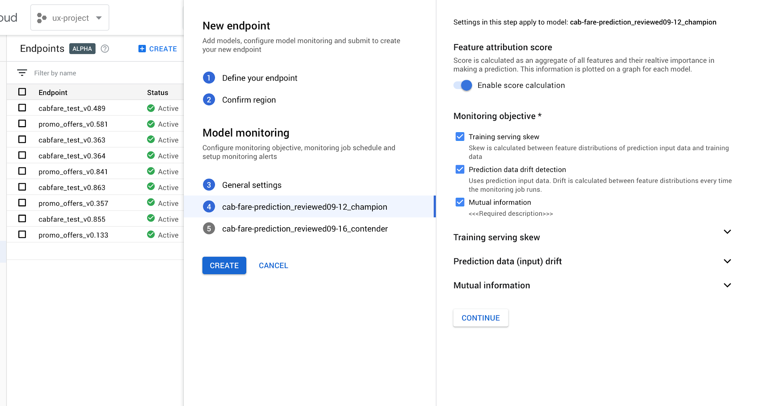
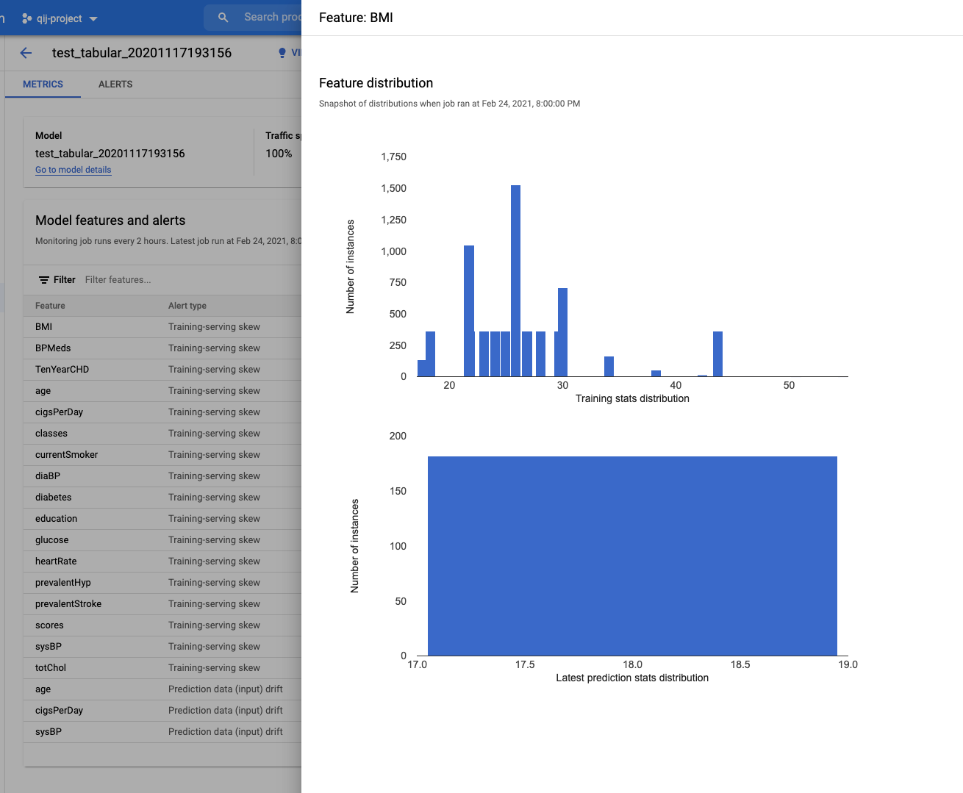
Vertex Model Monitoring
Automatically alert your data scientists and ML engineers when model performance changes
Detect drift and training-serving skew
Provides confidence in model reliability
Vertex Model Monitoring
Automatically alert your data scientists and ML engineers when model performance changes
Detect drift and training-serving skew
Provides confidence in model reliability
Notes:
Messaging info from Olivia: - Model Monitoring and Managed Pipelines alerts mitigate the need for constant supervision of models
For ML Engineers, MLOps makes it easier to catch all of the models coming from data scientists and manage through instrumentation.

Slide 36
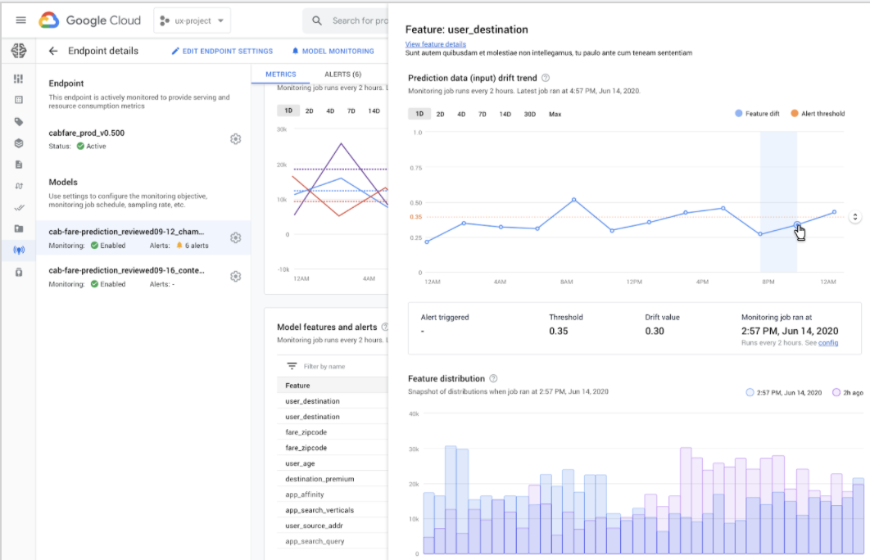
Easy and proactive monitoring of model performance
NDA
Monitor and alert
For model’s predictive performance
Diagnose
Identify the cause for the deviation
Update Model
Trigger model re-training pipeline

Slide 37
Drift and skew detection
Visualize drift over time
Easily compare latest feature distributions with baseline
Easily set or update alerting thresholds
Notes:
First lets start with the basics of monitoring a model….you want to monitor the inputs of the model for drift or skew

Slide 38
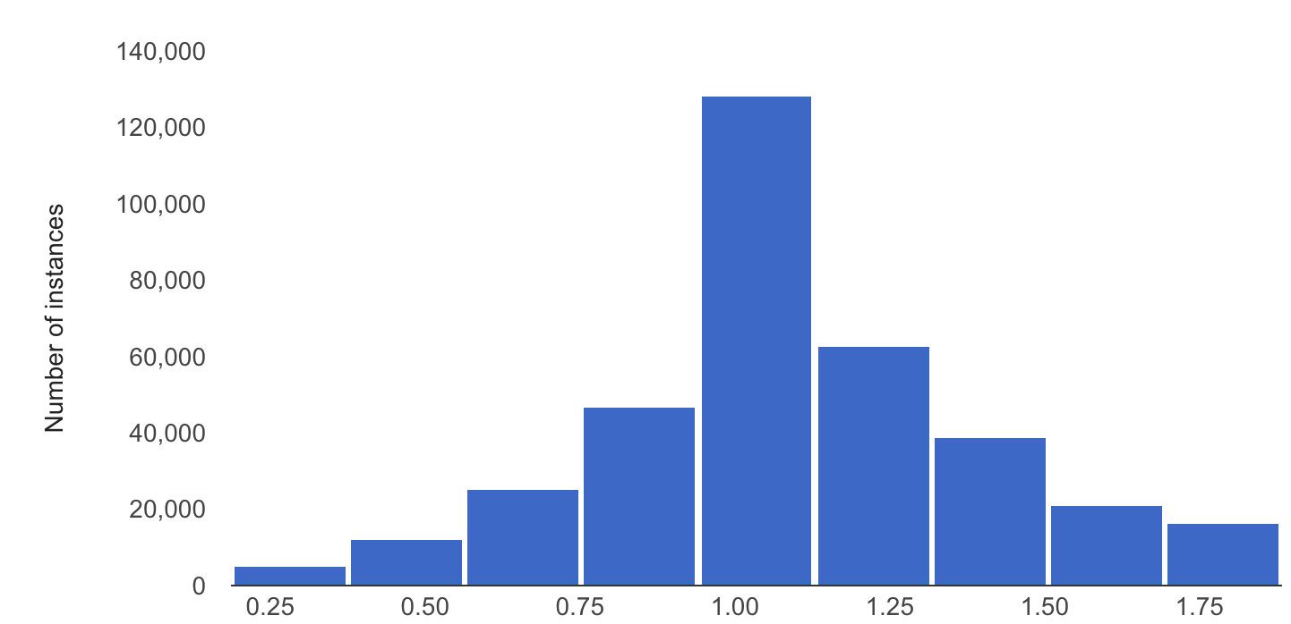


How to detect Skew and Drift
For Skew: set the baseline with stats of the training data
For Drift: set the baseline with the stats of the serving data in the past
Measure:
JS divergence (for numerical features)
L-inf distance (for categorical features)

Slide 39
Vertex Feature Store
05

Slide 40
Feature management pain points
ML Development
Hard to reuse
Feature Management
Code & Config
Training Operationalization
Hard to serve
Training pipeline
Continuous Training
Training serving skew
Registered model
Model Deployment
Deployed model
Prediction Serving
Serving logs
Continuous Monitoring
Notes:
You can now manage your models with confidence using our MLOps suite, to remove the complexity of robust self-service model maintenance and repeatability.
First, experimentation is a crucial component of ML to build the most optimal models.
You need tools that embrace the trial and error nature of ML and help you and your team track and manage your experiment.
With this in mind, we created the Vertex Feature Store.
It serves as the data source for experimentation, continuous training and online serving
This way you avoid training-serving skew, help prevent bias and ensure that up-to date feature values are served.

Slide 41
Feature management with Vertex Feature Store
ML Development
Reusable
Vertex
Feature Store
Code & Config
Training Operationalization
Easy to serve
Training pipeline
Continuous Training
Easy to avoid skew
Registered model
Model Deployment
Deployed model
Prediction Serving
Serving logs
Continuous Monitoring
Notes:
You can now manage your models with confidence using our MLOps suite, to remove the complexity of robust self-service model maintenance and repeatability.
First, experimentation is a crucial component of ML to build the most optimal models.
You need tools that embrace the trial and error nature of ML and help you and your team track and manage your experiment.
With this in mind, we created the Vertex Feature Store.
It serves as the data source for experimentation, continuous training and online serving
This way you avoid training-serving skew, help prevent bias and ensure that up-to date feature values are served.

Slide 42

特徴量にまつわる様々な課題
データ サイエンティストや Ops エンジニア、チーム間 で特徴量の計算方法がまちまちで、再利用できていない
— 大手投資銀行
特徴量の共有と再利用
特徴量のオンライン サービング
Training-Serving Skew
特徴量のオンライン サービングが難しく、多くのモデルが使えない
— モバイルアプリの開発会社
サービング環境を適切に実装できているか自信がない。学習時と推論時で同じ特徴量を異なる方法で扱ってしまい、運用時に精度が出ない
— 大手 e コマース企業

Slide 43
Customer pain #1
Lack of feature reuse and sharing
Proprietary + Confidential
No standard practice for how to compute features - team members have different ways of computing customer click-rate, so makes it difficult to reuse across different models.”
— Global Finance Company
Multiple teams are re-creating the same features, leading to redundant work and thus lost productivity
When a high quality feature is underutilized, i.e. not used across all use cases where it can add value, it represents a lost opportunity for the organization.
Discovering and sharing ml features across an organization, for training and serving in production, requires specialized tooling optimized to enable this use case.
Multiple solutions in retail can leverage the same set of features (Example: Product catalog features). Having a common feature repository could accelerate deployment of these solutions”
— Popular Online Retail Company

Slide 44
Customer pain #2:
Building online feature serving infra is hard
Proprietary + Confidential
Many models are not used in online prediction due to the challenge of serving features online.”
— Digital Native company with a top 30 mobile app
Serving feature values at scale, with low latency and high availability is not easy
Customers often have to hire small teams of Software and Ops engineers to build and maintain infrastructure for feature serving
Data Scientists are dependent on the Ops team each time they want to add a new feature, thus slowing down their velocity
Every time a data scientist needs to provide a feature for online serving, they must contact IT to see if a feature is available and negotiate on how the feature will be represented.”
— European online travel company

Slide 45
Customer pain #3:
Offline-online feature inconsistency
Proprietary + Confidential
When we synthesize features offline, it is difficult to ensure it captures what the user would have actually seen online. e.g., difficult to select attributions from the right time window..”
— Data Scientist from popular social app
Leading cause of: “model worked great offline, but not when it was deployed in production”
The silent killer of many production deployments
Hard to identify and debug
Prevention is better than a cure
A constant worry is whether we implemented it correctly on the serving end. We’ve even had simple errors like treating the same feature as different types -- integer vs float -- for training vs serving, leading to poor model performance in production..”
— Leading eCommerce company

Slide 46
“Rule #29: Make sure you train like you serve;
save the set of features used at serving time,
and use them at training time”
From Rules of ML paper

Slide 47
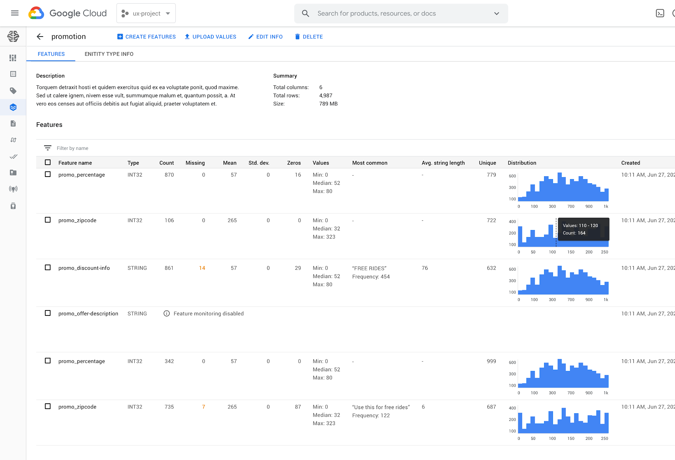
Vertex Feature Store
特徴量の共有と再利用
学習と推論で利用する特徴量を使いやすい API で取得
スケーラブル・低遅延で特徴量をサービング
特徴量のオンライン サービングが容易に
Training-Serving Skew を軽減
特徴量を学習と推論で再利用
特徴量の分布変化を継続監視
‹#›
Notes:
Feature Store: Online serving, yes. Streaming ingestion, no
Feature Store is a centralized repository of feature data. This means feature engineering work can be shared across teams, so that time and effort calculating features is not wasted.
Share and reuse ML features across use cases
Centralized feature repository with easy APIs to search & discover features, fetch them for training/serving and manage permissions.
Serve ML Features at scale with low latency
Offload the operational overhead of handling infrastructure for low latency scalable feature serving.
Alleviate training serving skew
Compute feature values once, re-use for training and serving
Track & monitor for drift and other quality issues
Official messaging to possibly include: Feature Store streamlines and optimizes the most time consuming, operational and redundant elements of ML
MLOps Feature Store helps you to avoid redundant work
Feature Store streamlines and optimizes the most time consuming, operational and redundant elements of ML (alleviating ML Engineers from unknowingly repeating engineering work completed by another team, operationalizing features with SWE/Ops teams and troubleshooting production issues caused by feature computation inconsistencies).

Slide 48
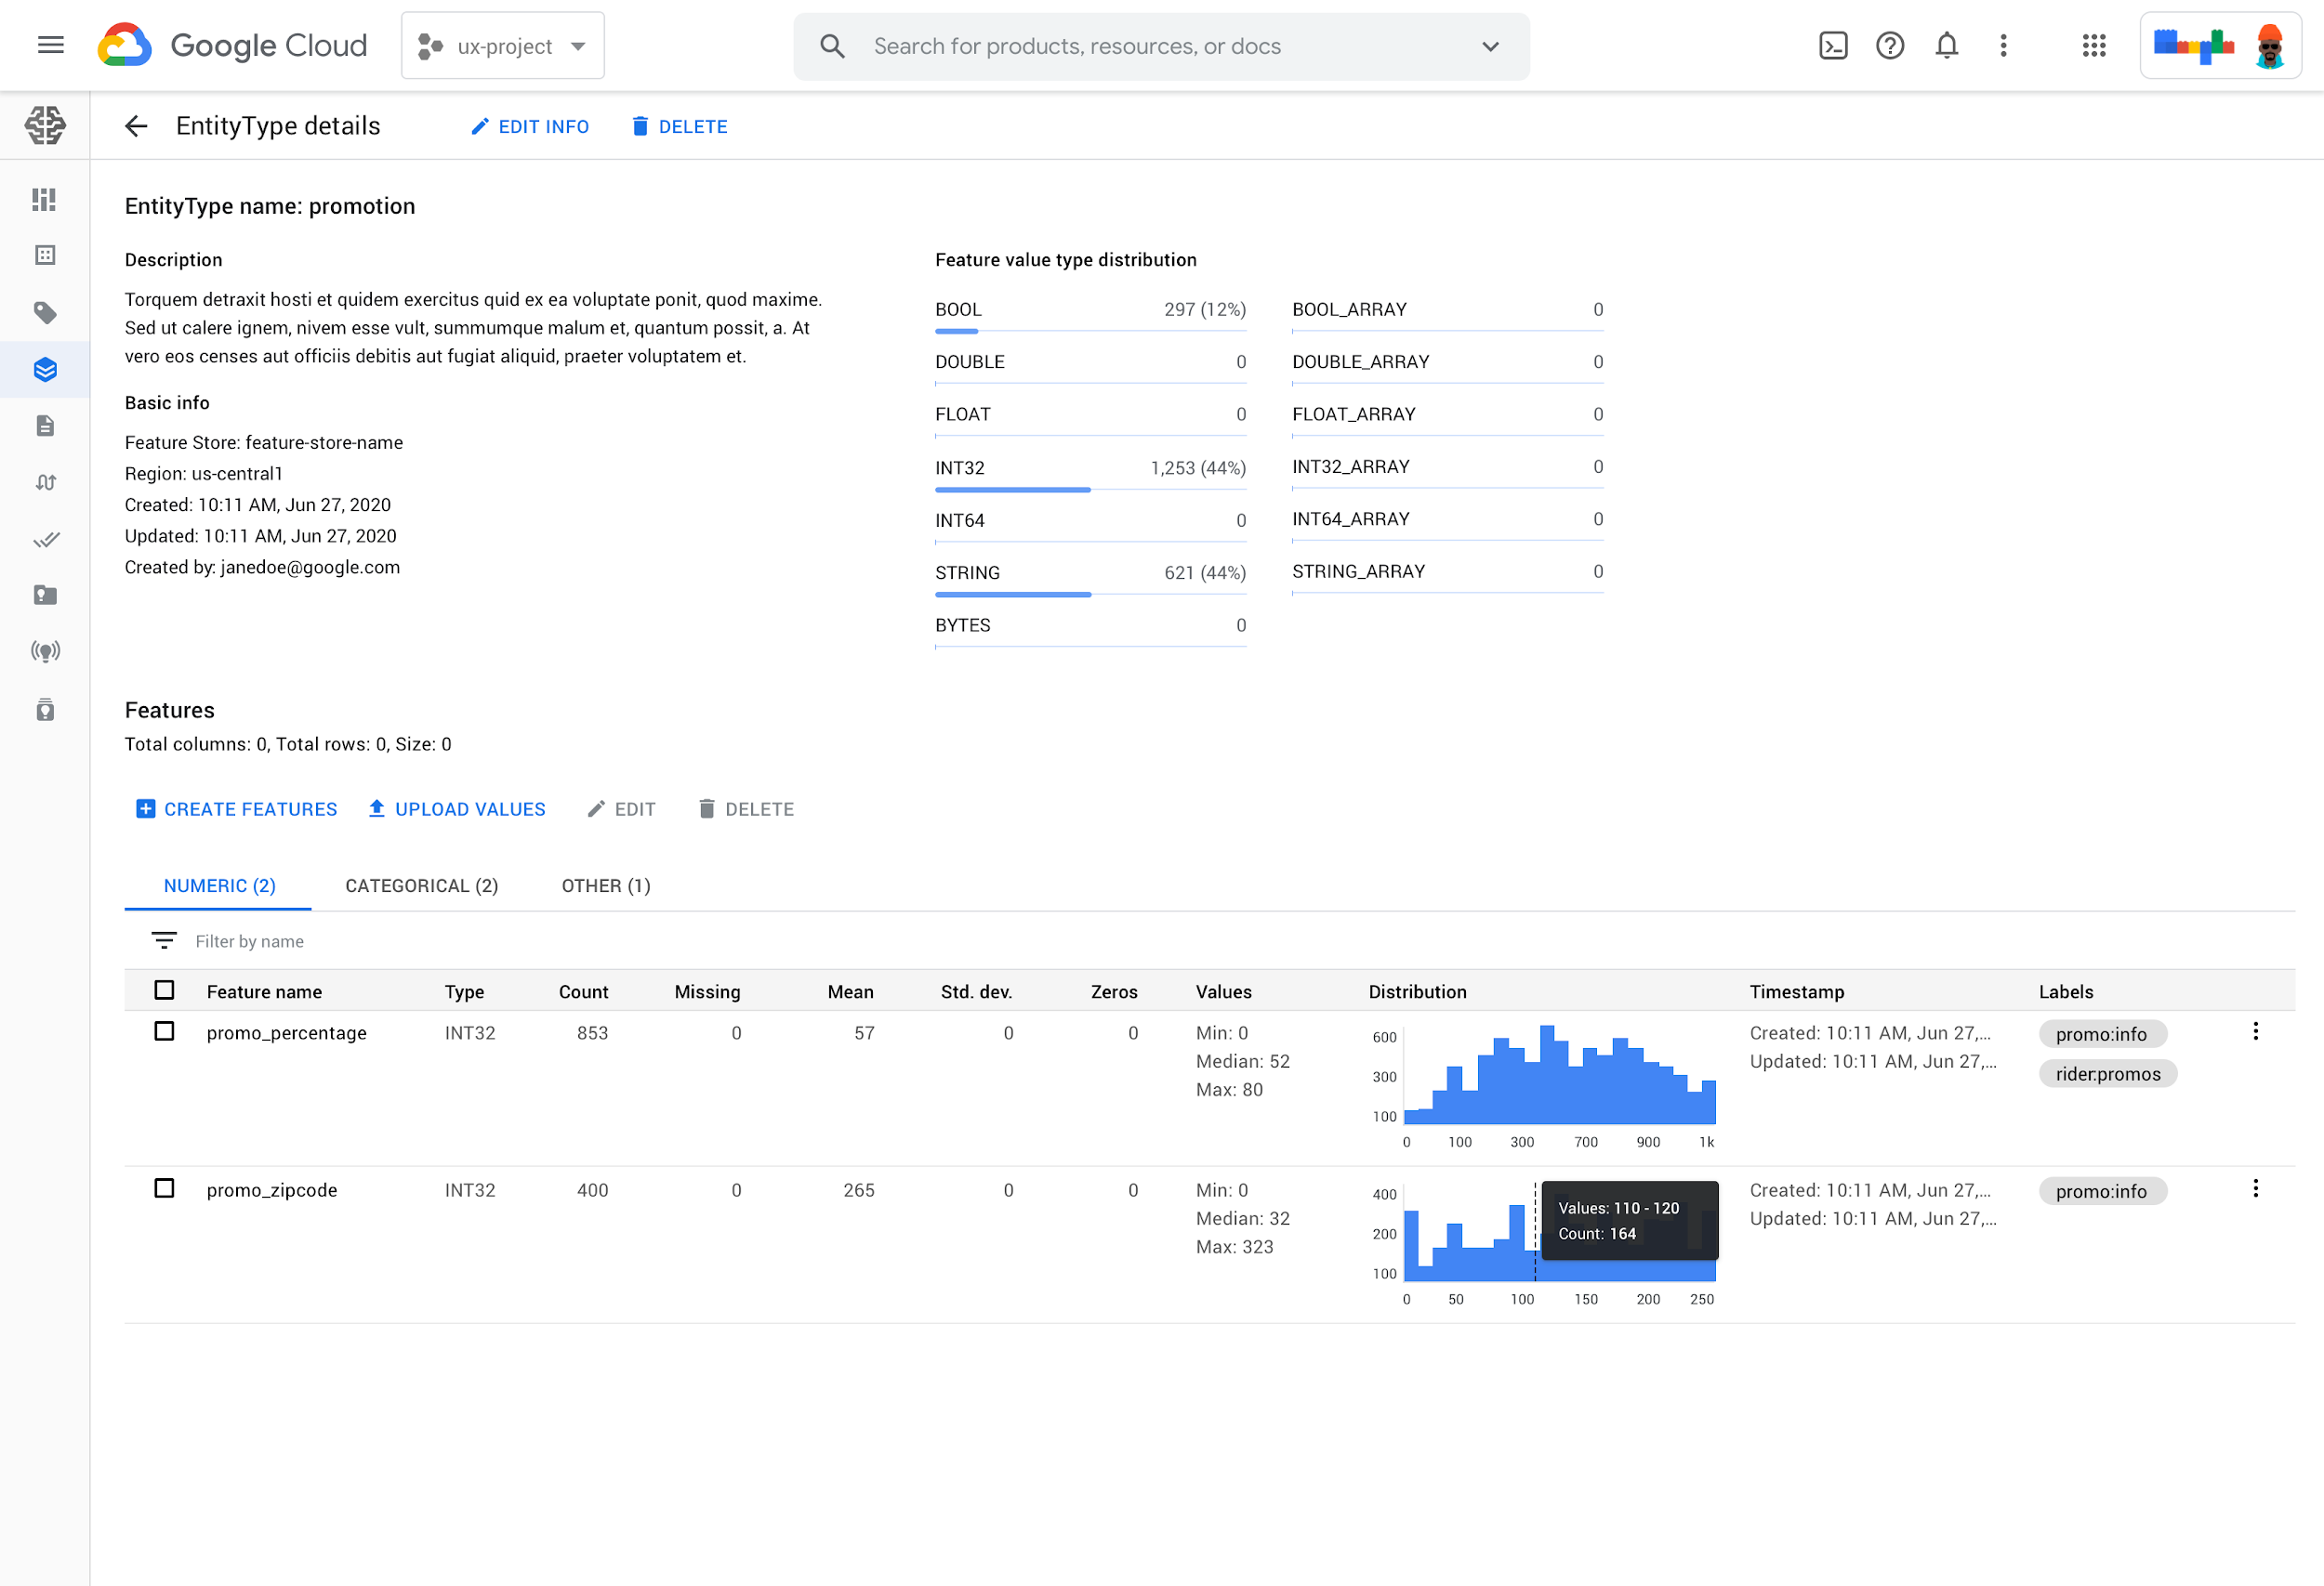
Fully managed Feature Store
A rich feature repository to serve, share and re-use ML features.
Share and reuse ML features across use cases
Centralized feature repository with easy APIs to search & discover features, fetch them for training/serving and manage permissions.
Serve ML Features at scale with low latency
Offload the operational overhead of handling infrastructure for low latency scalable feature serving.
Alleviate training serving skew
Compute feature values once, re-use for training and serving
Track & monitor for drift and other quality issues

Slide 49
Feature Store の API と SDK
Our Solution
Feature Store
Data Lake (BQ, GCS)
Feature Management API
Registry
Feature Discovery API
Cache
Batch Feature Engineering
Batch Ingestion API
Online Store
Online Serving API
Online Prediction
Feature Monitoring
Streaming Feature Engineering
Stream Ingestion API
Offline Store
Point-in-time lookups
Batch Serving API
Model Training
Kafka/Pubsub
Notes:
https://docs.google.com/drawings/d/1pp3Oi2PE86Kte7Nm9sQLKvMcsDdwdPjB4Rxe6vwmXmA/edit?resourcekey=0-Yg-vii4Wj6a2dytaGDJDWw

Slide 50
Simple Data Scientist friendly APIs & SDKs
abstract away the underlying complexity
Feature Store
Data Lake (BQ, GCS)
Feature Management API
Registry
Feature Discovery API
Cache
Batch Feature Engineering
Batch Ingestion API
Online Store
Online Serving API
Online Prediction
Feature Monitoring
Streaming Feature Engineering
Stream Ingestion API
Offline Store
Point-in-time lookups
Batch Serving API
Model Training
Kafka/Pubsub
Notes:
https://docs.google.com/drawings/d/1pp3Oi2PE86Kte7Nm9sQLKvMcsDdwdPjB4Rxe6vwmXmA/edit?resourcekey=0-Yg-vii4Wj6a2dytaGDJDWw

Slide 51
Point-in-time 機能
指定した時刻での特徴量を提供、データリークを防ぐ
Training Labels
L1
L2
L1
L2
Feature 1
4
1
3
9
7
1
9
2
3
7
Feature 2
7
8
3
7
8
Feature 3
T
T
F
F
T
T
F
Time
T1
T2

Slide 52
Efficient Point-in-time Lookups to prevent Data Leakage
For each labelled training instance, fetch the value of requested features at that point in time
Training Labels
L1
L2
L1
L2
Feature 1
4
1
3
9
7
1
9
2
3
7
Feature 2
7
8
3
7
8
Feature 3
T
T
F
F
T
T
F
Time
T1
T2
Read this blog post for a detailed explanation of Data Leakage.

Slide 53
Vertex Matching Engine
06

Slide 54
Embeddings/Representations: Today’s cutting edge paradigm in AI/ML
Similarity Matching
(i.e. find nearest neighbors)
Embedding (i.e. vector)
Representations
Data
Deep Learning Models
Predictions
Ranking/Scoring
(w/ Deep Learning Models)
Step 1: Train Semantic Embeddings
Represent entities as vectors, that capture relevant semantic information. Trained via a wide variety of machine learning models. BERT, Swivel, GNNs, Inception, etc etc.
Step 2: Find similar entities & score them for relevance
Finding similar entities is via an Approximate Nearest Neighbor (ANN) service. Scoring is done with a machine learning model.

Slide 55
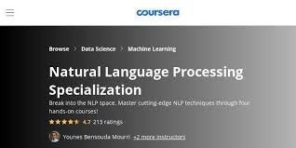

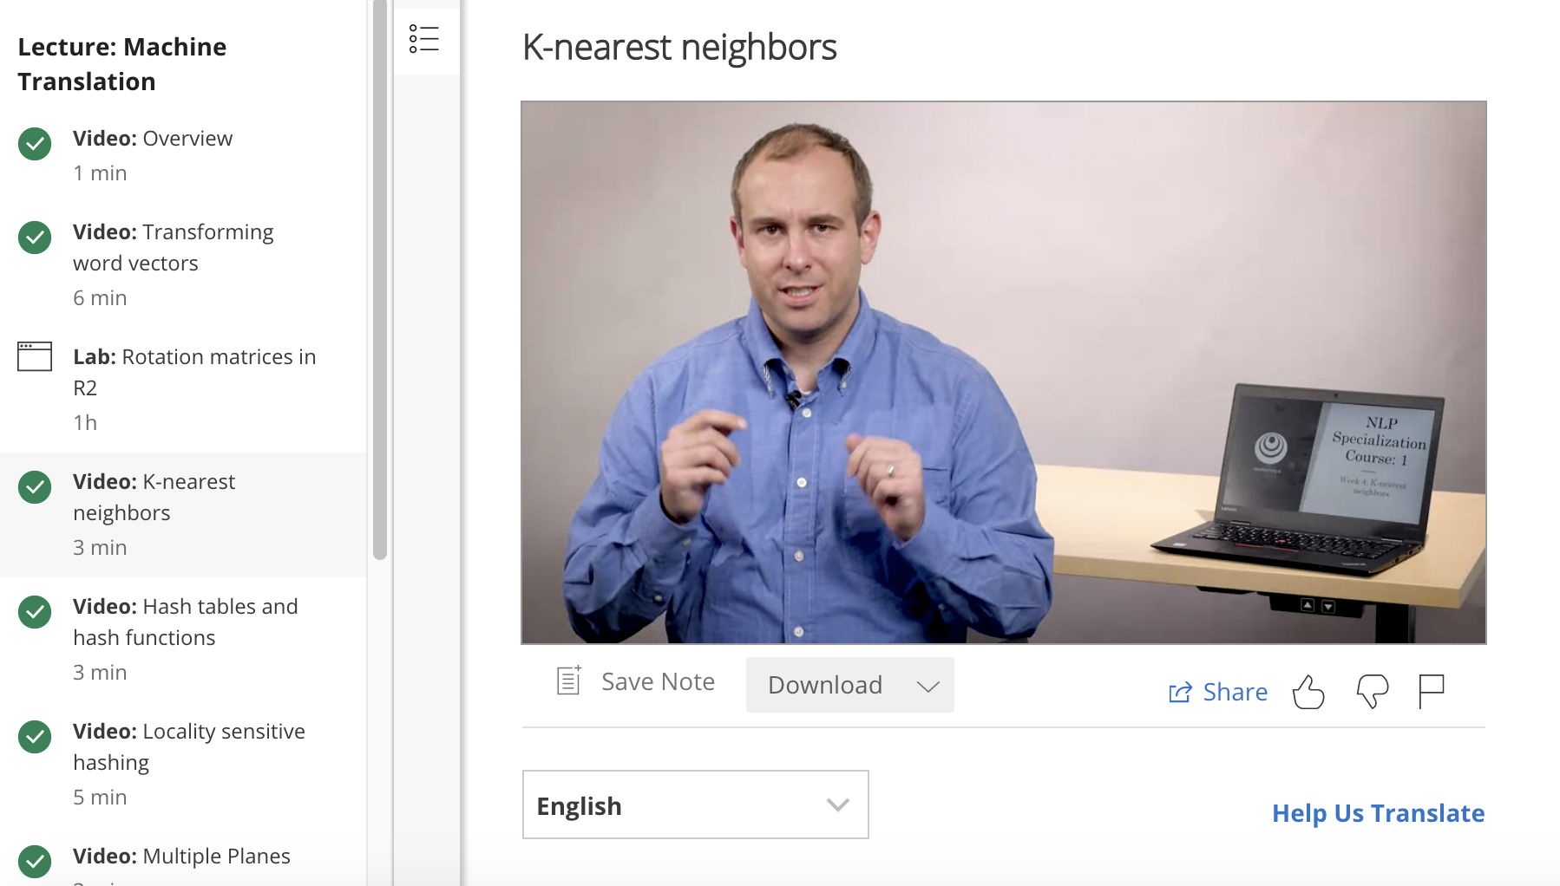
Computing embeddings of text and finding semantically similar text via a nearest neighbor search on these embeddings, is a key building block of contemporary NLP
“….finding the K nearest neighbors of a vector. We will focus on this operation in the next few videos as it is a basic building block for many NLP techniques”

Slide 56

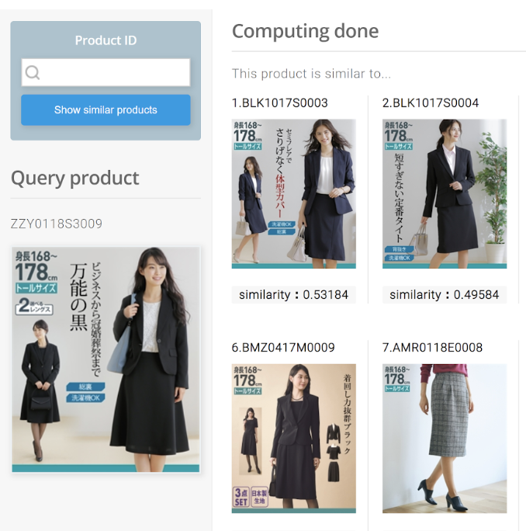



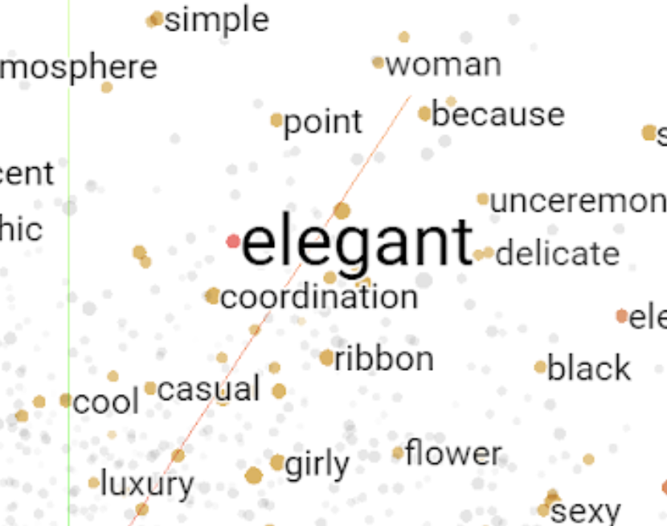
the largest mail-order service in Japan
Visual embeddings
(shape, color, style)
Language embeddings
(product description)
Combined
embeddings
Recommendation with insights of
the sense and use cases
CTR, CVR and session time has increased significantly
Notes:
A production use case of deep learning based item recommendation for apparel goods, developed by Nissen (one of the largest mail order-based retailers in Japan).
This system has two parts: 1) apply CNN for classifying the items with their visual features, and 2) apply NLP model (word embedding) on product description and user comments for classifying items with their use cases for consumers.
With those two tasks, audience can experience how CNN and NLP running with Cloud AI services can learn the insights on apparel and lifestyle goods for solving various business challenges such as recommendation service and market analysis. With these, CTR, CVR and session time of the Nissen's commerce site has increased significantly.
For more details, please see:
https://docs.google.com/document/d/1a-OlllgOy5tcIX6j62EMEe_7VjW6K3GfICXG1LxLl4U/edit#heading=h.kxwyl2xcy6z6

Slide 57

Approximate Nearest Neighborhood search (ANN) is a key step
For use cases such as Ad targeting, content recommendations, document matching, image similarity and many more
Example,
App Store Recommendations
Large App corpus
Candidate generator
Reranker
Optimisation
Performing this step at scale requires an ANN service.

Slide 58
Key Challenges in deploying an ANN service
Operational overhead with existing options
Customers currently use open source solutions. Getting these open source solutions up and running, and managing them, adds significant operational overhead
Scale
Existing solutions do not scale, or are not cost effective at scale
Usability
Existing solutions deliver very basic capabilities. They lack essential usability features required in most real-world architectures.

Slide 59
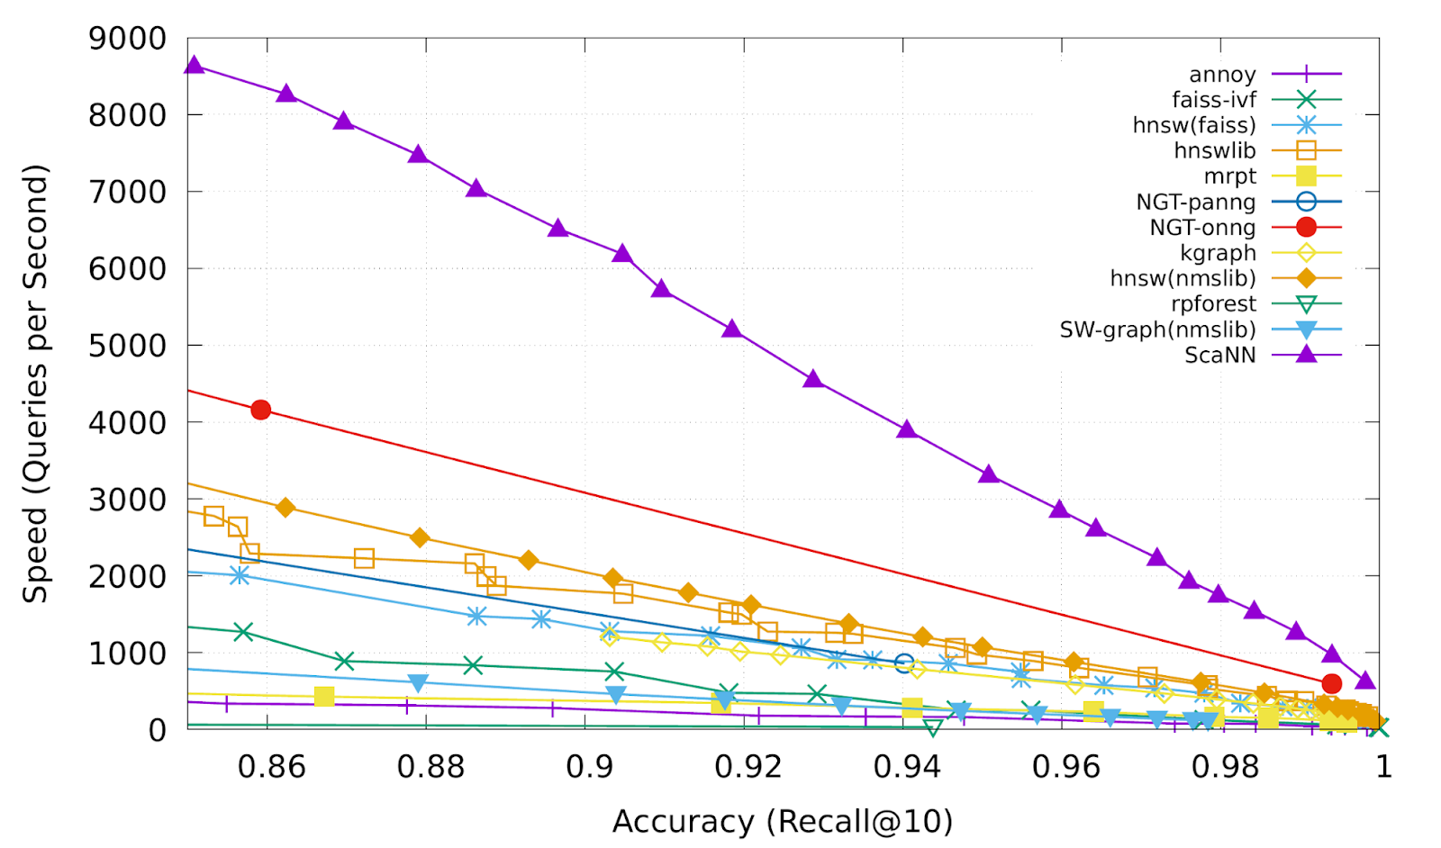
Approximate Nearest Neighborhood search (ANN) on Cloud AI
Ultra-scalable, low latency search service
Our solution
Faster i.e low latency
Find nearest neighbors in a few millisecond
The most scalable
Scales to billions of vectors
Cheaper
Requires fewer VMs to serve the same workload
1/4th the CPU consumption of faiss
1/3rd the memory consumption of nmslib
Google’s technology (labelled ScaNN) compared with popular ANN services
Notes:
Add some notes about the graph

Slide 60
Differentiated value added capabilities of GCP’s ANN Service
In addition to the speed, scale and cost benefits
Our solution
Incremental indexing
Add new vectors to an existing index, without needing to rebuild the index from scratch.
Filtering based on tags
Associate one or more tags with each vector, and specify filtering predicates based on the tags at query time.
Ensure Diversity of results
Ability to balance accuracy and diversity via simple config params
Auto-tuning
Smart selection of configuration parameters

Slide 61
ANN Service roadmap
Roadmap
Q4 2020
Q1 2021
Q2 2021
Experimental release
Public Preview Release
Autoscaling
Incremental Indexing
GA release
Advanced filtering
VPC-SC & CMEK support

Slide 62
Next steps

Slide 63
Resources
AI Platform Product Page
cloud.google.com/ai-platform
MLOps solution page
cloud.google.com/solutions/machine-learning/mlops-continuous-delivery-and-automation-pipelines-in-machine-learning
Continuous Training with TFX and AI Platform
github.com/GoogleCloudPlatform/mlops-on-gcp/tree/master/workshops/tfx-caip-tf23

Slide 64

Thank you
Notes:
Open it up to questions

Slide 65
Vertex AI Pipelines
Hands-on workshop
04

Slide 66
Prep: get your GCP account
Open: ***
Pick one account and add your name
Open an Incognito Window on Chrome and open console.cloud.google.com
Log in with the GCP account

Slide 67
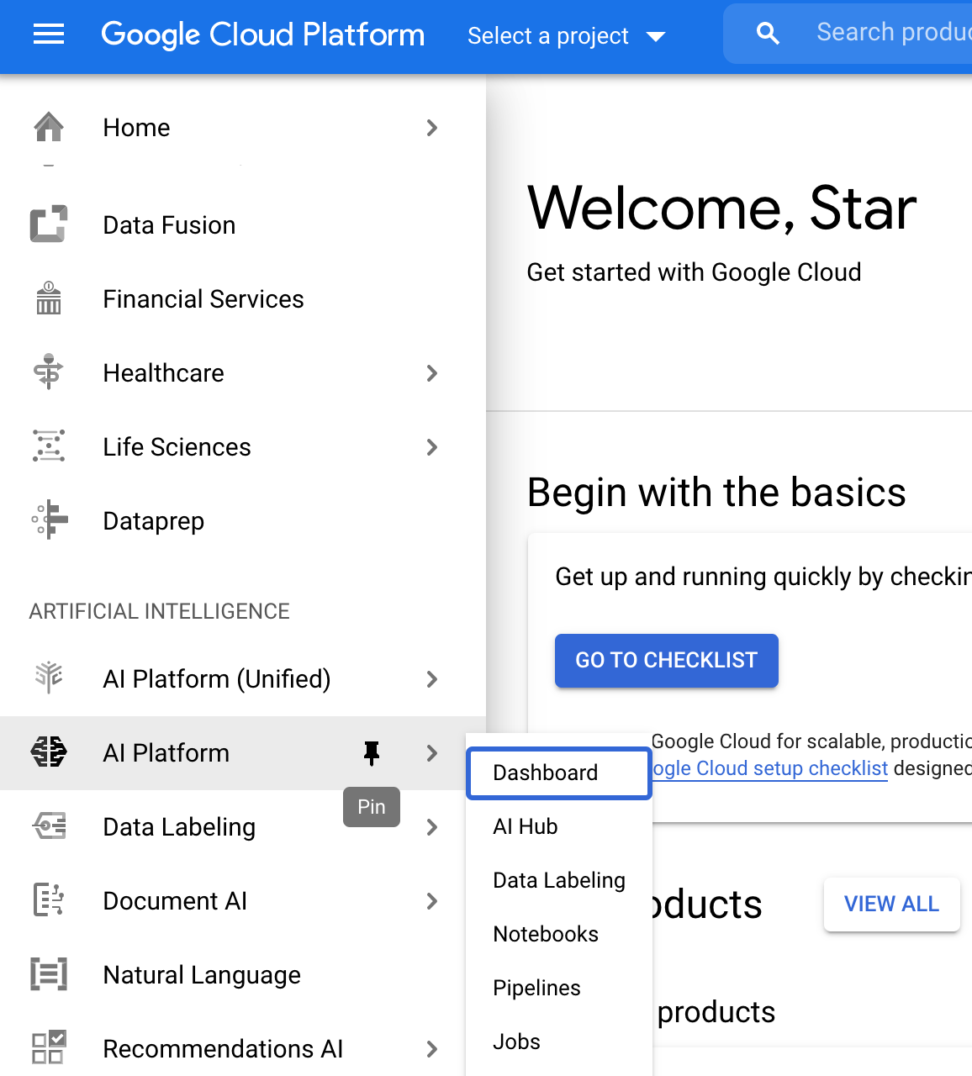
Getting Started with AI Platform Pipelines
At the left navigation menu, find ARTIFICIAL INTELLIGENCE > AI Platform (not Unified) and pin it.
On Select a project menu at the top, choose the pre-created project
Open: http://bit.ly/3iUtEol
Follow the instruction
(You can skip the last Clean up part)

Slide 68


Slide 69
Run the demos
Open Kubeflow Pipelines console
Select Pipelines > [Demo] TFX - Irix > Create run > Start

Slide 70


Slide 71
Take a look at the demo results
Open Kubeflow Pipelines console
Open Experiments > Default > Run of [Demo] Iris...
Click statisticsgen > Visualizations and see TFDV stats on the UI
Click schemagen > Visualizations and see the schema on the UI
Open Artifacts > iris_native_keras > model > Lineage Explorer

Slide 72

(Optional) Using Pipelines with Notebooks
Open the sample Notebook: https://bit.ly/2NCROYY
Follow the instruction with Google Colab
Caveats: you'd need to create some GCS buckets

